Slide 1

RETHINKING PRODUCT DESIGN:
Innovations required for the microinsurance market
OLA OYEKAN, PhD
Microinsurance Specialist
RGA Reinsurance South Africa
19 May 2017

Slide 2
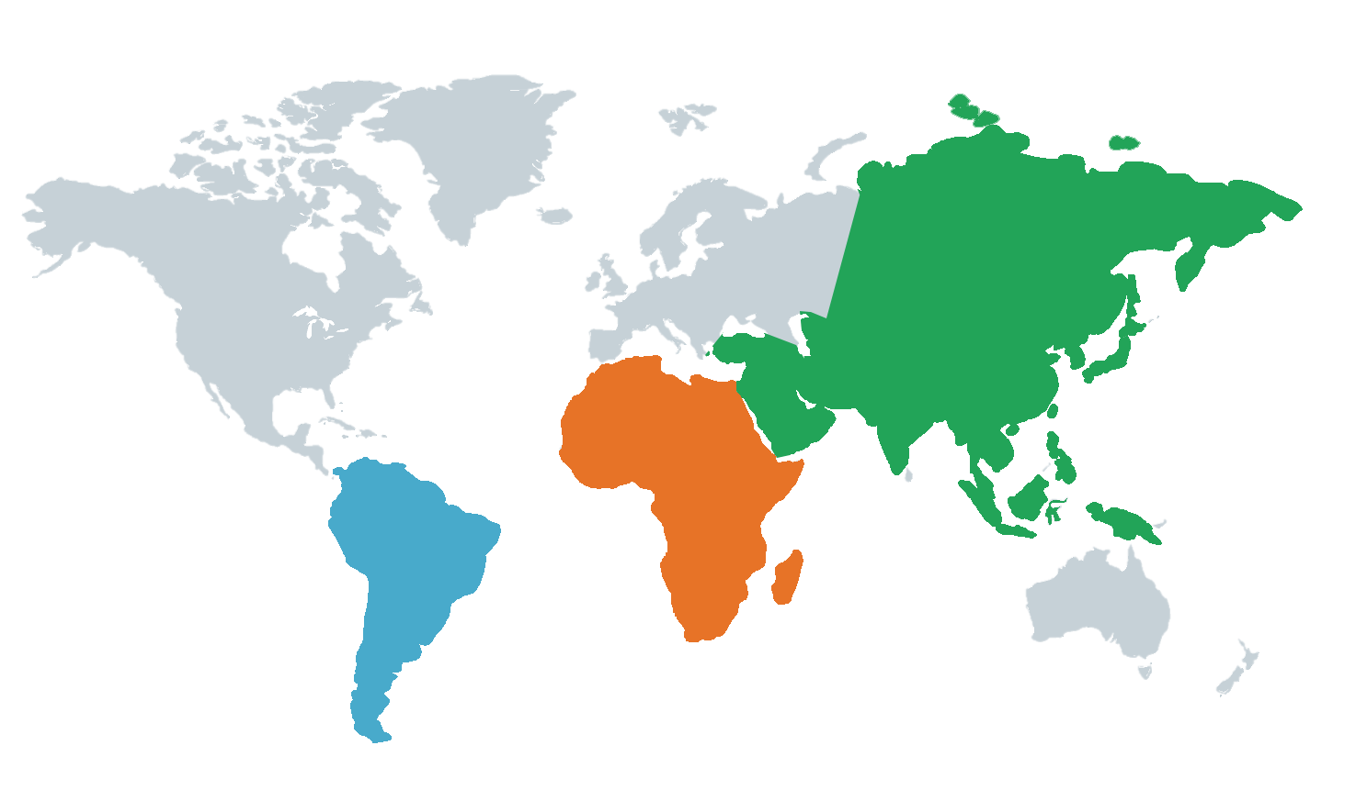

Global Landscape of Microinsurance
170
million
62
million
49
million
US$ 2.4 billion
Notes:
- microinsurance has grown significantly across all regions over the past decade, from around 70m lives covered in 2007 to over 300m lives ( and over 500 million policies sold) covered in 2015. The Microinsurance centre landscape studies show that there are around 49 million lived covered in LAC, 62m lives in Africa, and 170m lives in Asia.. These policies account for over 2.4 billion USD in GWP across all regions. Although total premiums still a small percentage of total insurance premiums , it is a significant amount of new business and lives which were previously uninsured.
In terms of products, the studies how that;
Simple life, credit life and pa → LAC, same for Africa
Simple life, pa, health and agri for Asia.

Slide 3



Product Evolution
Increasing scale and business case
Expanding product types
Voluntary;
Better features and benefits
Mandatory;
Basic credit life and funeral
Source: Microinsurance centre, RGA Research
Notes:
Microinsurance products have evolved over the past decade. Early products were predominantly mandatory credit life attached to microloans. This was followed by product greater product sophistication, with voluntary benefits and choice. No we see expanding product types,… such as health, agri(weather index), property and personal accident products ………..bundling of insurance with other services e.g. health, retail and utility purchases. A number of providers are experien

Slide 4








Product Innovation: Case studies
Quid Cover
Surgical Cash
Fracture Cover
Source: RGA Research

Slide 5

Key Learnings
Simple
Tangible benefits
Align distribution channel
Leverage technology
Emergence of on-demand, usage-based products

Slide 6
Thank you!

