Slide 1

RETHINKING PRODUCT DESIGN:
Innovations required for the microinsurance market
NIGEL BOWMAN
Inclusivity Solutions
19 May 2017

Slide 2


A few product design lessons
4 lessons from 4 case studies
Notes:
What is Moodle?
The Actuarial society set out to improve the way course information and activities are coordinated and presented to students.
For this purpose the Moodle platform was selected and implemented in 2015 as ASSA’s Learning management system.
Moodle as a Learning Management System that is web based and allow ASSA to administer and track courses online. This platform is accessible to registered student via the web. It will be used to receive relevant course material and documentation as well as to manage submissions of assignments and other documentation for example all Work Based Learning forms and documents. The Moodle platform also allows students to collaborate and take part in other course activities such as discussion forums or the peer review of assignments.
Moodle has been used by the F200 Course Leaders over the last couple of years. In 2015 we started to implement all other courses on Moodle with a staggered roll-out plan over 3 years for all ASSA courses.
2016 will see the full implementation of all ASSA education courses on Moodle that are not currently already active on the system.
These and other Moodle functions will be discussed further on in this presentation.

Slide 3
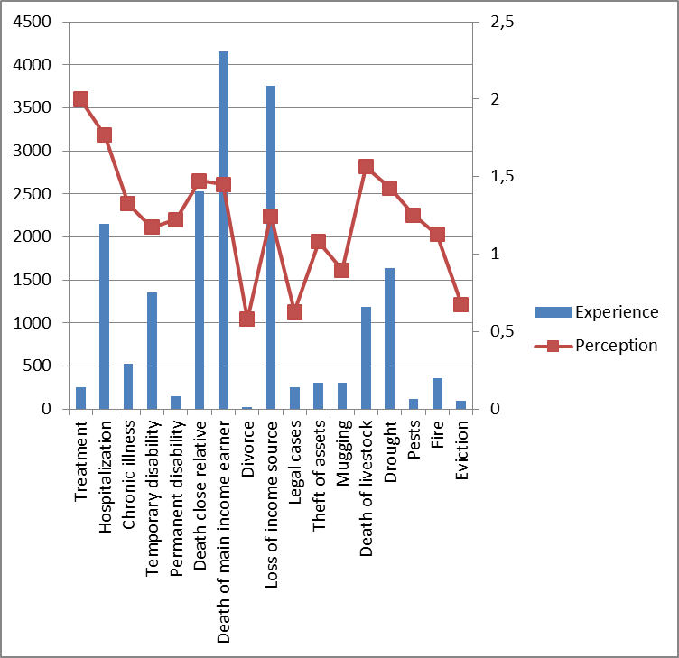
Kenya financial diaries data
RISK TYPE |  | RANKING
 |  | Perception | Experience
MEDICAL | Treatment | 2,001 | 252,45
 | Hospitalization | 1,768 | 2154,75
 | Chronic illness | 1,326 | 527,85
 | Temporary disability | 1,175 | 1360
 | Permanent disability | 1,222 | 147,9
DEATH | Death close relative | 1,475 | 2529,6
 | Death of main income earner | 1,45 | 4153,1
DIVORCE | Divorce | 0,58 | 23,8
INCOME | Loss of income source | 1,248 | 3760,4
CRIME | Legal cases | 0,63 | 249,9
 | Theft of assets | 1,08 | 309,4
 | Mugging | 0,897 | 309,4
HOME AND LAND | Death of livestock | 1,564 | 1190
 | Drought | 1,428 | 1636,25
 | Pests | 1,254 | 117,3
 | Fire | 1,127 | 359,55
 | Eviction | 0,675 | 98,6
Source: http://fsdkenya.org/financial-diaries/
Notes:
What is Moodle?
The Actuarial society set out to improve the way course information and activities are coordinated and presented to students.
For this purpose the Moodle platform was selected and implemented in 2015 as ASSA’s Learning management system.
Moodle as a Learning Management System that is web based and allow ASSA to administer and track courses online. This platform is accessible to registered student via the web. It will be used to receive relevant course material and documentation as well as to manage submissions of assignments and other documentation for example all Work Based Learning forms and documents. The Moodle platform also allows students to collaborate and take part in other course activities such as discussion forums or the peer review of assignments.
Moodle has been used by the F200 Course Leaders over the last couple of years. In 2015 we started to implement all other courses on Moodle with a staggered roll-out plan over 3 years for all ASSA courses.
2016 will see the full implementation of all ASSA education courses on Moodle that are not currently already active on the system.
These and other Moodle functions will be discussed further on in this presentation.

Slide 4

Kenya financial diaries data – design implications
MARKETING FOCUS:
Design for high perceived needs
versus
CUSTOMER VALUE FOCUS:
design for experienced need
Potential approach: design initial product mostly for risk perception (need to get customers to trust insurance → be aware of value), subsequent products according to need.
Lessons
Understand both perception of risks and actual experience of risks → find right balance.
Don’t abuse misplaced risk perceptions. Accident insurance?
Notes:
What is Moodle?
The Actuarial society set out to improve the way course information and activities are coordinated and presented to students.
For this purpose the Moodle platform was selected and implemented in 2015 as ASSA’s Learning management system.
Moodle as a Learning Management System that is web based and allow ASSA to administer and track courses online. This platform is accessible to registered student via the web. It will be used to receive relevant course material and documentation as well as to manage submissions of assignments and other documentation for example all Work Based Learning forms and documents. The Moodle platform also allows students to collaborate and take part in other course activities such as discussion forums or the peer review of assignments.
Moodle has been used by the F200 Course Leaders over the last couple of years. In 2015 we started to implement all other courses on Moodle with a staggered roll-out plan over 3 years for all ASSA courses.
2016 will see the full implementation of all ASSA education courses on Moodle that are not currently already active on the system.
These and other Moodle functions will be discussed further on in this presentation.

Slide 5

Affordable housing product
An insurer designed a market first affordable housing product for the SA market.
Initial price halved during internal approval process
Price was halved again by the business → revised price was still unaffordable.
No existing experience → pricing actuary had added substantial margins to higher income experience on assumption that low income segment was substantially riskier.
Lessons
Don’t automatically assume low income / microinsurance market is riskier than traditional market. E.g. tighter community bonds often mitigate higher risk factors.
Check affordability as part of pricing.
Notes:
What is Moodle?
The Actuarial society set out to improve the way course information and activities are coordinated and presented to students.
For this purpose the Moodle platform was selected and implemented in 2015 as ASSA’s Learning management system.
Moodle as a Learning Management System that is web based and allow ASSA to administer and track courses online. This platform is accessible to registered student via the web. It will be used to receive relevant course material and documentation as well as to manage submissions of assignments and other documentation for example all Work Based Learning forms and documents. The Moodle platform also allows students to collaborate and take part in other course activities such as discussion forums or the peer review of assignments.
Moodle has been used by the F200 Course Leaders over the last couple of years. In 2015 we started to implement all other courses on Moodle with a staggered roll-out plan over 3 years for all ASSA courses.
2016 will see the full implementation of all ASSA education courses on Moodle that are not currently already active on the system.
These and other Moodle functions will be discussed further on in this presentation.

Slide 6
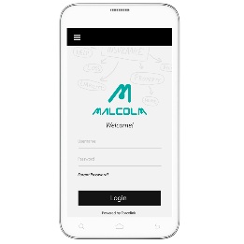
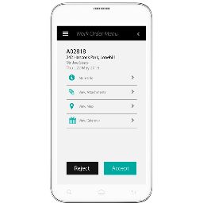
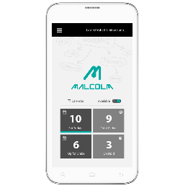
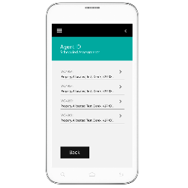
Uberization changes market dynamics?
Cost of claims assessment can be major barrier in microinsurance (e.g. asset and crop insurance)
Inclusivity Solutions has uberized the assessment process:
  Platform directs nearest available assessor to site
  Guides assessment
  Digital submission via mobile
Lessons
Identify cost barriers in value chain and use technology to remove them.
Microinsurance innovations likely to disrupt traditional insurance → there are lessons to be learnt.
Notes:
What is Moodle?
The Actuarial society set out to improve the way course information and activities are coordinated and presented to students.
For this purpose the Moodle platform was selected and implemented in 2015 as ASSA’s Learning management system.
Moodle as a Learning Management System that is web based and allow ASSA to administer and track courses online. This platform is accessible to registered student via the web. It will be used to receive relevant course material and documentation as well as to manage submissions of assignments and other documentation for example all Work Based Learning forms and documents. The Moodle platform also allows students to collaborate and take part in other course activities such as discussion forums or the peer review of assignments.
Moodle has been used by the F200 Course Leaders over the last couple of years. In 2015 we started to implement all other courses on Moodle with a staggered roll-out plan over 3 years for all ASSA courses.
2016 will see the full implementation of all ASSA education courses on Moodle that are not currently already active on the system.
These and other Moodle functions will be discussed further on in this presentation.

Slide 7

Tanzania funeral insurance
Two leading mobile operators launched free funeral cover for subscribers who meet loyalty criteria
Expected
Increased revenue
Upsell opportunity
What actually happened?
Subscribers called to have free cover cancelled – thought they were being cursed!
Lessons
Design around need – not what you think the need is, but what potential customers say the need is!
Don’t assume one market approach will work in another market.
Notes:
What is Moodle?
The Actuarial society set out to improve the way course information and activities are coordinated and presented to students.
For this purpose the Moodle platform was selected and implemented in 2015 as ASSA’s Learning management system.
Moodle as a Learning Management System that is web based and allow ASSA to administer and track courses online. This platform is accessible to registered student via the web. It will be used to receive relevant course material and documentation as well as to manage submissions of assignments and other documentation for example all Work Based Learning forms and documents. The Moodle platform also allows students to collaborate and take part in other course activities such as discussion forums or the peer review of assignments.
Moodle has been used by the F200 Course Leaders over the last couple of years. In 2015 we started to implement all other courses on Moodle with a staggered roll-out plan over 3 years for all ASSA courses.
2016 will see the full implementation of all ASSA education courses on Moodle that are not currently already active on the system.
These and other Moodle functions will be discussed further on in this presentation.

Slide 8

Quick summary of lessons
Design around LOCAL need as expressed by your market
Balance perceived risks against experienced risks
Micro $≠$ high risk, at least not always
Watch the microinsurance space for disrupting innovations
Thank you!
Notes:
What is Moodle?
The Actuarial society set out to improve the way course information and activities are coordinated and presented to students.
For this purpose the Moodle platform was selected and implemented in 2015 as ASSA’s Learning management system.
Moodle as a Learning Management System that is web based and allow ASSA to administer and track courses online. This platform is accessible to registered student via the web. It will be used to receive relevant course material and documentation as well as to manage submissions of assignments and other documentation for example all Work Based Learning forms and documents. The Moodle platform also allows students to collaborate and take part in other course activities such as discussion forums or the peer review of assignments.
Moodle has been used by the F200 Course Leaders over the last couple of years. In 2015 we started to implement all other courses on Moodle with a staggered roll-out plan over 3 years for all ASSA courses.
2016 will see the full implementation of all ASSA education courses on Moodle that are not currently already active on the system.
These and other Moodle functions will be discussed further on in this presentation.

