Slide 1
The impact of diversification levels on the risk-adjusted performance of South African risk-factor based equity portfolios
(or, can you have too much of a free lunch?)
Prof. Evan Gilbert (MI and USB) and Rowan Douglas (UCT)
investments and savings

Slide 2
What’s the problem?
Smart beta products are growing in popularity
Their investment performance is a function of:
  Investment thesis (e.g. Value/Momentum/Size factor)
  Diversification strategy (Market Cap/Equally weighted/other)
  Rebalancing (monthly/quarterly/annually)
Focus today ➔ assessing the impact of different diversification strategies
Specific research questions:
  Is more diversification always better from a risk-adjusted returns perspective?
  Is there an optimal level of diversification?
  Do these answers differ by investment thesis (factor)?

Slide 3
How did we answer these questions?
Creating the portfolios
Identified four smart beta/factor-based investment theses
  Value, Momentum, Size, Low (historical) Volatility
  Top 20 shares identified for each investment thesis
Four alternative diversification strategies were applied:
  Market cap – reference/benchmark portfolios
  Alternative methods:
    Equally weighted (EW)
    Minimum volatility (MinVol)
    Equal risk contribution (ERC)
    Maximum diversification ratio (MDR)
Rebalanced monthly
  Transaction costs included (50 bps on each buy/sell leg)
Liquidity adjusted
  Shares available for inclusion adjusted for portfolio size (R100m used in this case)

Slide 4
How did we answer these questions?
Levels of diversification and risk-adjusted performance
We identified relative scores (to the Market Cap portfolios) on two dimensions for each alternative diversification strategy portfolio:
  Relative levels of diversification
  Relative levels of risk adjusted performance
We used two proxies for each dimension:
  Levels of diversification:
    Diversification Score
    Concentration Score
  Risk-adjusted performance:
    Information Ratio (risk = volatility, market cap portfolio = benchmark)
    Omega-Sharpe Ratio (risk = Omega Ratio, r_{f} rate = 3m t-bill)
Looked at both averages over the entire and we conducted regression analyses rolling periods on these two dimensions:
  Is there a significant positive linear relationship between them?
    Does more diversification lead to higher risk-adjusted performance?
  Is there a concave quadratic relationship between them?
    Does diversification help, then hurt the levels of risk adjusted performance?
    In other words, is there evidence of “di-worse-ification”?

Slide 5
Investment theses used
1. Value
The specific definitions used and references used to identify these dimensions are:
Definition
Equally weighted combination of*:
International References
Basu (1977, 1983)
South Africa references
Van Rensburg (2001)
Book Value to Market Value
Earnings to Price
Cash flow to Price
Dividend Yield
Fama and French (1992, 1993, 1998)
Chan, Karceski, and Lakonishok (1997)
Bauman and Miller (1998)
Piotrowski (2000)
Ang (2009)
Hsu and Kalesnik (2014)
Amenc et al. (2016)
Van Rensburg and Robertson
(2003)
Auret and Sinclaire (2006)
Mutooni and Muller (2007)
Strugnell, Gilbert and Kruger (2011)
Muller and Ward (2013)
*All shares are ranked in terms of the individual dimensions and then the rankings are averaged to get a factor ranking per share (i.e. each dimension is equally weighted)

Slide 6
Investment theses used
2. Momentum
The specific definition used and references used to identify this dimension are:
Definition
12m historical price return
International References
Jegadeesh and Titman (1993)
South Africa references
Van Rensburg and Robertson
Amenc et al. (2016)
(2003)
Auret and Sinclaire (2006)
Basiewicz and Auret (2010)
Muller and Ward (2013)

Slide 7
Investment theses used
3. Size
The specific definition used and references used to identify this dimension are:
Definition
Market Capitalisation (not free float adjusted)
International References
Banz (1981)
South Africa references
Van Rensburg and Robertson (2003)
Basiewicz and Auret (2010)
Fama and French (1992)
Auret and Sinclaire (2006)
Schmidt, Von Arx, Schrimpf, Wagner, and Ziegler (2016)
Strugnell, Gilbert and Kruger (2011)
Muller and Ward (2013)

Slide 8
Investment theses used
4. Low Historical Volatility
The specific definition used and references used to identify this dimension are:
Definition
12m historical volatility
International References
Alighanbari et al. (2016)
South Africa references
None

Slide 9
Diversification strategies used (1/2)
Richard and Roncalli (2015)
We used exactly the same diversification strategies as this seminal paper:
Market Cap Weighted (MC)
1. Equally Weighted (EW)
Weight = Market (normalised over market cap of entire portfolio)
No adjustment for free float
Weight = 1/n
2. Minimum Volatility Weighted (MV)
Weights ➔ minimise overall portfolio variance
Variance/Covariance matrix based on rolling 12m return history
n = no. of shares in the portfolio (20)
Becomes the benchmark for the alternative strategies:
Diversification levels and
Risk adjusted returns

Slide 10
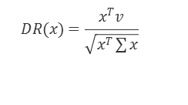
Diversification strategies (2/2)
Richard and Roncalli (2015)
We used exactly the same diversification strategies as this seminal paper:
3. Equal Risk Contribution Weighted (ERC)
4. Most Diversified Portfolio Weighted (MDP)
Weight = equalised marginal risk contribution of each stock (risk = variance)
Marginal risk contribution is the partial derivative of the portfolio variance to the individual’s share weighting
Total risk contribution for any individual share = weight x marginal risk contribution and the ERC equalises these for all shares in the portfolio
Weights = maximum diversification ratio (DR) for a portfolio
DR = Ratio of sum of weighed share volatility to overall portfolio volatility:
Uses 12m historical returns for the Variance/Covariance matrix
Uses 12m historical returns for the Variance/Covariance matrix
$$DR(x)=\frac{x^{T}v}{\sqrt{x^{T}\sum{x}}}$$
Note: x is the vector of stock weights at that time, T indicates the transpose, v is the vector of individual stock volatilities and ∑ is the variance/covariance matrix.
Both the individual share volatilities and the variance/covariance matrix are estimates on 12m historical returns.

Slide 11
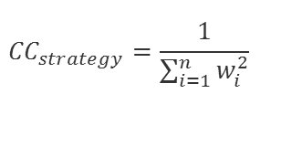

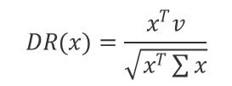

Diversification measures
We calculate these measures to compare the relative levels of diversification:
Diversification Score (DS)
Concentration Coefficient/Score
DR = Ratio of weighted sum of individual share volatilities/Portfolio volatility (same as that used in the MDP approach)
CC = inverse of Herfindahl-Hirschman index (HHI)
CS = ratio of CC for diversification strategy to CC of MCAP strategy -1
Most diversified portfolio strategy using this measure: MDP
Result is inverted to give positive value for higher portfolio diversification (Brandes, 2004)
HHI calculated based on portfolio weights
DS = relative DR_{strategy} to DR_{CAP}
Most diversified portfolio strategy using this measure: EW strategy
$$DR(x)=\frac{x^{T}v}{\sqrt{x^{T}\sum{x}}}$$
$$DS=\frac{{DR}_{DivStrat}}{{DR}_{MCAP}}−1$$
$${CC}_{strategy}=\frac{1}{\sum_{i=1}^{n}{w_{i}^{2}}}$$
${CS}_{Strategy}=\frac{{CC}_{strategy}}{{CC}_{MCAP}}$ - 1

Slide 12
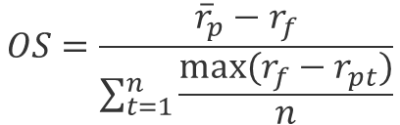

Risk and performance measures used
We calculated two risk adjusted performance measures:
Information Ratio
Active return/Std Dev (Active Returns)
Omega Sharpe Ratio
MCAP portfolio = benchmark
Risk proxy: Volatility
Reference rate = Rf rate = 3m t-bill rate
Measure of relative risk-adjusted performance
Risk proxy = Omega Ratio
Kazemi et.al. (2003) based on Shadwick and Keating (2002)
IR$=\frac{r_{p}−r_{BM}}{TE}$
$$OS=\frac{{\overline{r}}_{p}−r_{f}}{\sum_{t=1}^{n}{\frac{max⁡(r_{f}−r_{pt})}{n}}}$$

Slide 13
Relative diversification levels for alternative diversification strategies
The relative performance reported is the average of the measure , calculated at month end from January, 1995 – December 2015.
Most diversified portfolio strategies for each relative diversification measure

Slide 14
Relative risk-adjusted returns (for entire period relative to MCAP portfolios)
The relative performance reported below is the median of the annual measure values calculated over independent, calendar year periods.

Slide 15
Information and Sharpe-Omega ratios
Sign test p-values for differences in means
 | Equally Weighted | Minimum Volatility | Equal Risk Contribution | Most Diversified Portfolio
Information Ratio
Size Factor | 0.07% | 0.36% | 0.36% | 9.46%
Low Volatility | 33.18% | 50.00% | 50.00% | 66.82%
Momentum | 19.17% | 50.00% | 50.00% | 66.82%
Value | 0.36% | 1.33% | 3.92% | 3.92%
Sharpe-Omega Ratio
Size Factor | 0.07% | 9.46% | 3.92% | 19.17%
Low Volatility | 9.46% | 50.00% | 33.18% | 50.00%
Momentum | 9.46% | 3.92% | 9.46% | 19.17%
Value | 1.33% | 3.92% | 9.46% | 3.92%

Slide 16
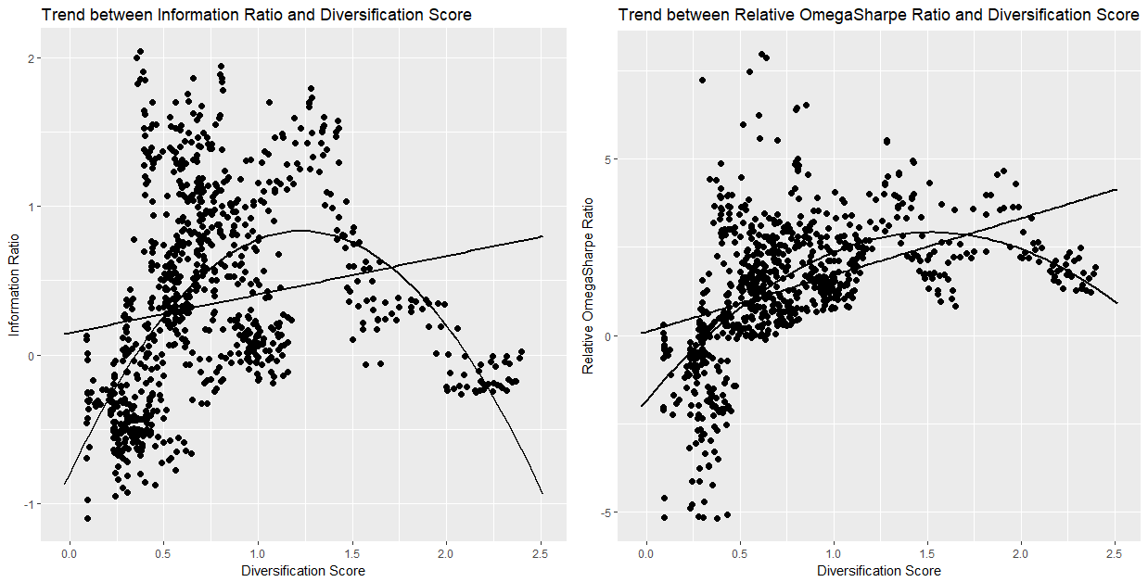
Momentum risk-factor regression results
Diversification score vs IR and Omega-Sharpe
The results below reflect relative diversification levels (monthly average) and risk adjusted performance for rolling 3 year periods:

Slide 17
Momentum risk-factor regression results
 | Model | Coefficient | p-value | Adj R²
DS and Information Ratio | Linear | 0.2592 | 0.00% | 3.10%
 | Quadratic | -1.0774 | 0.00% | 30.26%
DS and Sharpe-Omega Ratio | Linear | 1.6133 | 0.00% | 21.86%
 | Quadratic | -2.0547 | 0.00% | 41.12%
CS and Information Ratio | Linear | 0.3524 | 0.00% | 26.91%
 | Quadratic | -0.2096 | 0.00% | 46.33%
CS and Sharpe-Omega Ratio | Linear | 0.9656 | 0.00% | 38.09%
 | Quadratic | -0.3360 | 0.00% | 50.28%

Slide 18
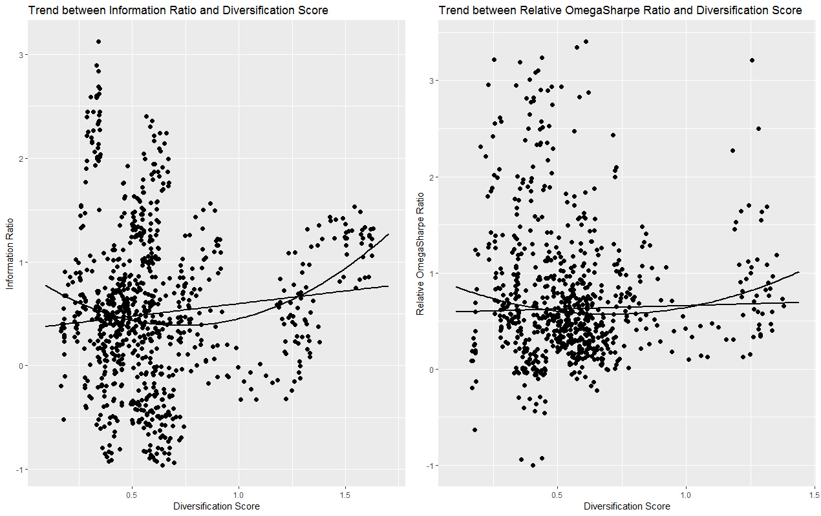
Value risk-factor regression results
Diversification score vs IR and Omega-Sharpe
The results below reflect relative diversification levels (monthly average) and risk adjusted performance for rolling 3 year periods:

Slide 19
Value risk-factor regression results
 | Model | Coefficient | p-value | Adj R²
DS and Information Ratio | Linear | 0.2428 | 0.02% | 1.10%
 | Quadratic | 0.9412 | 0.00% | 3.78%
DS and Sharpe-Omega Ratio | Linear | 0.0736 | 39.96% | 0.01%
 | Quadratic | 0.8126 | 0.09% | 1.50%
CS and Information Ratio | Linear | 0.3404 | 0.00% | 24.38%
 | Quadratic | 0.0812 | 0.00% | 26.34%
CS and Sharpe-Omega Ratio | Linear | 0.1391 | 0.00% | 5.39%
 | Quadratic | -0.0215 | 34.03% | 5.53%

Slide 20
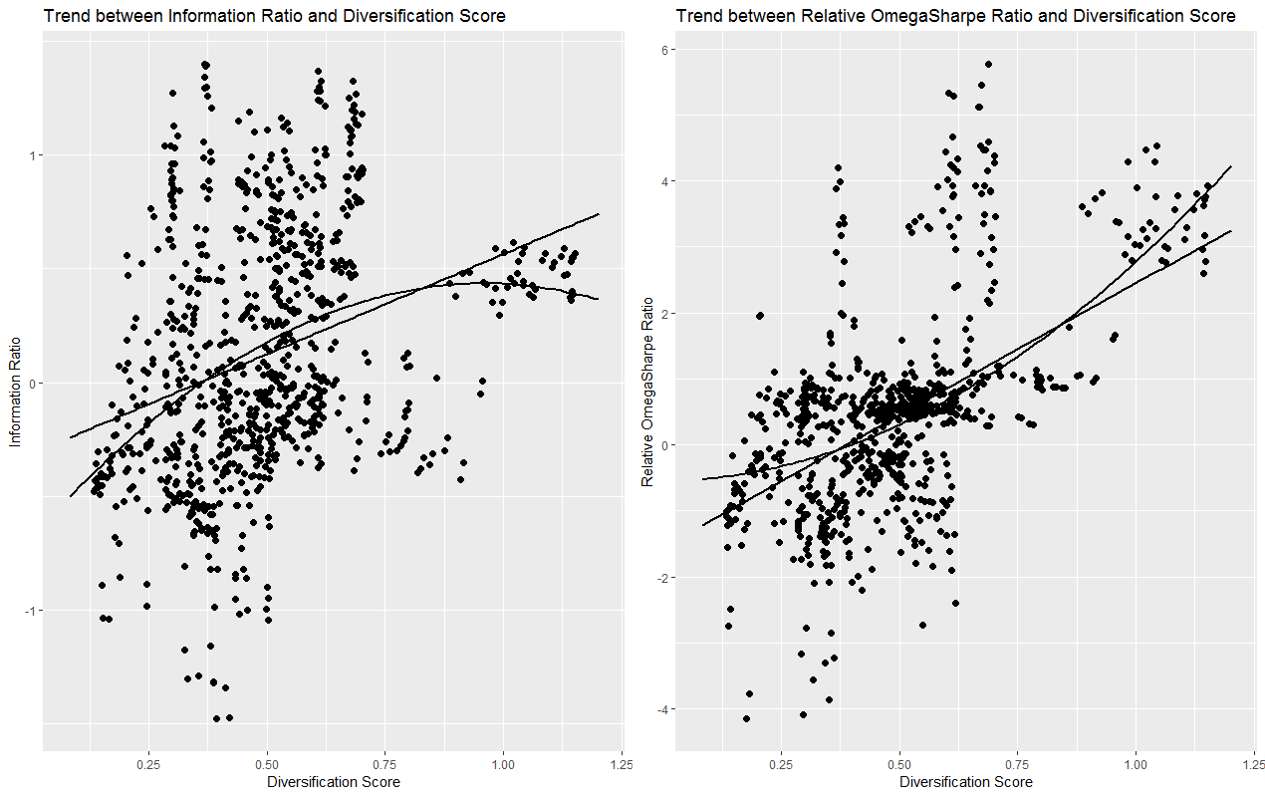
Low Volatility risk-factor regression results
Diversification score vs IR and Omega-Sharpe
The results below reflect relative diversification levels (monthly average) and risk adjusted performance for rolling 3 year periods:

Slide 21
Low Volatility risk-factor regression results
 | Model | Coefficient | p-value | Adj R²
DS and Information Ratio | Linear | 0.8784 | 0.00% | 10.03%
 | Quadratic | -1.2197 | 0.00% | 12.39%
DS and Sharpe-Omega Ratio | Linear | 3.9922 | 0.00% | 37.17%
 | Quadratic | 3.2280 | 0.00% | 40.30%
CS and Information Ratio | Linear | 0.0403 | 27.41% | 0.05%
 | Quadratic | -0.6167 | 0.00% | 18.26%
CS and Sharpe-Omega Ratio | Linear | 0.1497 | 32.98% | 0.38%
 | Quadratic | -1.1337 | 0.00% | 21.04%

Slide 22
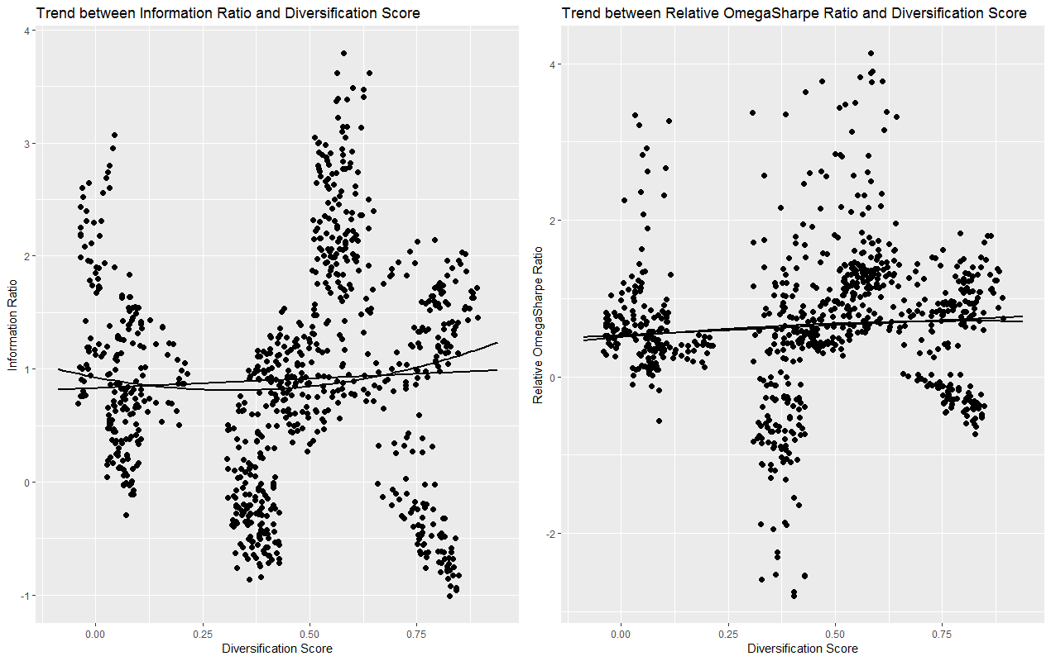
Size risk-factor regression results
Diversification score vs IR and Omega-Sharpe
The results below reflect relative diversification levels (monthly average) and risk adjusted performance for rolling 3 year periods:

Slide 23
Size risk-factor regression results
 | Model | Coefficient | p-value | Adj R²
DS and Information Ratio | Linear | 0.1674 | 21.20% | 0.08%
 | Quadratic | 1.1121 | 4.92% | 0.57%
DS and Sharpe-Omega Ratio | Linear | 0.2523 | 0.41% | 0.69%
 | Quadratic | -0.2915 | 50.85% | 0.62%
CS and Information Ratio | Linear | -0.2970 | 17.52% | 0.05%
 | Quadratic | -9.0622 | 0.00% | 4.74%
CS and Sharpe-Omega Ratio | Linear | -0.4651 | 1.21% | 0.53%
 | Quadratic | -5.0538 | 0.00% | 2.82%

Slide 24
Conclusions
The alternative diversification strategies all increased the levels of diversification relative to the Market Cap portfolios
The average levels of relative risk-adjusted performance were higher over the whole period for the alternative portfolios
However there is very limited evidence for:
  A consistently significant and meaningful positive linear relationship or
  A significant and meaningful concave quadratic relationship
This suggests that increasing levels of diversification are a good idea, but there does not seem to much value in maximising them
  A relatively simple strategy such are the EW approach is probably sufficient for most Smart Beta portfolios
The one exception seems to be the Momentum risk factor
  It’s not clear why this factor seems to be different
  More research is required to understand why this is the case

