Slide 1

Banking Analytics
Author: Pravin Burra & FC de Vos
Date: Sept 2018

Slide 2
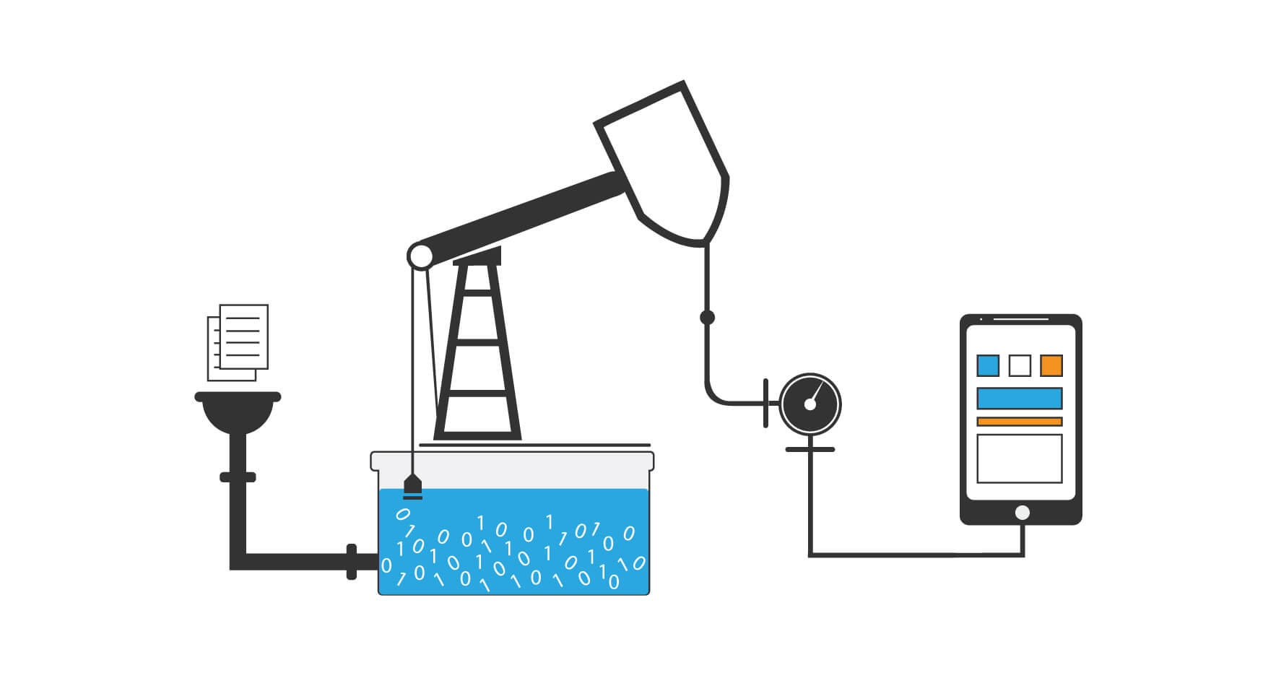
Data is the new oil
What data?
Who are the new oil men?
Oil in what machine?
Notes:
Moodle log-on:
Use this website address to access the Moodle site. It might be a good idea to create this link as a favorite or shortcut in your internet browser for easy access to Moodle every time.
Moodle is a secure system where all user activities can be tracked. You will receive username and default password information from the society via email once you’ve successfully registered for a course. Use this information to log-on to Moodle for the 1st time.
After your 1st log-on the system will ask you to change your password to ensure that only you can access your account.
This new password must adhere to the following conditions:
It must be at least 8 characters long
It must contain at least 1 uppercase letter
It must contain at least 1 special character like a question mark or hash sign etc.
Only passwords meeting these conditions will be accepted by the system.
4. Tip – tick the “remember username” box on the login screen for the system to remember your username and password details for easy access every time.
If you register for additional courses you will still use the same username and password to access all your courses in Moodle.

Slide 3
Does your data have purpose?
Focus on adoption
Adoption
Iterate
Rinse & repeat
The actuarial control cycle
Use Cases
Technology & Infrastructure
Start with the end in mind
Organisation & Governance
Notes:
Moodle log-on:
Use this website address to access the Moodle site. It might be a good idea to create this link as a favorite or shortcut in your internet browser for easy access to Moodle every time.
Moodle is a secure system where all user activities can be tracked. You will receive username and default password information from the society via email once you’ve successfully registered for a course. Use this information to log-on to Moodle for the 1st time.
After your 1st log-on the system will ask you to change your password to ensure that only you can access your account.
This new password must adhere to the following conditions:
It must be at least 8 characters long
It must contain at least 1 uppercase letter
It must contain at least 1 special character like a question mark or hash sign etc.
Only passwords meeting these conditions will be accepted by the system.
4. Tip – tick the “remember username” box on the login screen for the system to remember your username and password details for easy access every time.
If you register for additional courses you will still use the same username and password to access all your courses in Moodle.

Slide 4
The value of data
Income per customer
Cross and upsell
Down sell, customer mix
Margin
Product design, cost to serve (robotics, self service), behavioral migration, elasticity, underwriting
%
%
%
%
Number of customers
New to company, digital marketing, NTU analysis, reduce friction
Value
Term
Value - real & perceived.
Notes:
Moodle log-on:
Use this website address to access the Moodle site. It might be a good idea to create this link as a favorite or shortcut in your internet browser for easy access to Moodle every time.
Moodle is a secure system where all user activities can be tracked. You will receive username and default password information from the society via email once you’ve successfully registered for a course. Use this information to log-on to Moodle for the 1st time.
After your 1st log-on the system will ask you to change your password to ensure that only you can access your account.
This new password must adhere to the following conditions:
It must be at least 8 characters long
It must contain at least 1 uppercase letter
It must contain at least 1 special character like a question mark or hash sign etc.
Only passwords meeting these conditions will be accepted by the system.
4. Tip – tick the “remember username” box on the login screen for the system to remember your username and password details for easy access every time.
If you register for additional courses you will still use the same username and password to access all your courses in Moodle.

Slide 5
How change happens
1
2
3
4
INDIVIDUAL CONTRIBUTER
One person does the task
DELEGATION
Many people do the task
The task needs to be defined and standardise
DIGITISATION
We teach a computer to do the task
Automate mundane
It needs to be well codified, e.g. ATM
Not every task needs to be digitised
ANALYTICS
Machine learning
Continuous review
Human in the loop
Notes:
Moodle log-on:
Use this website address to access the Moodle site. It might be a good idea to create this link as a favorite or shortcut in your internet browser for easy access to Moodle every time.
Moodle is a secure system where all user activities can be tracked. You will receive username and default password information from the society via email once you’ve successfully registered for a course. Use this information to log-on to Moodle for the 1st time.
After your 1st log-on the system will ask you to change your password to ensure that only you can access your account.
This new password must adhere to the following conditions:
It must be at least 8 characters long
It must contain at least 1 uppercase letter
It must contain at least 1 special character like a question mark or hash sign etc.
Only passwords meeting these conditions will be accepted by the system.
4. Tip – tick the “remember username” box on the login screen for the system to remember your username and password details for easy access every time.
If you register for additional courses you will still use the same username and password to access all your courses in Moodle.

Slide 6

Team
Data Engineer
Data production
Production Engineers
Join the bits together
App building
Data Scientist
Widgets, (modules) APIs
Classification, scoring, forecasting
Business
Strategy, trade offs,
Channel execution

Slide 7




My Non-Traditional Data
Voice Data
What was said, how it was said, when was it said, in what context was it said
Email data
Categorization, routing, sequencing
System log data
Demand forecasting, sequencing, route cause analysis
Image data
FICA, identification, emotion
Notes:
Word embedding video
Emotion video

Slide 8
Personalisation
Source Data
Governance, architecture, staging
Consistent View of Customer
Feature library
Finance per segment
Journey mapping
Interaction journey
Life’s journey
Profiling
People like you
Portfolio tilt
Behavioral triggers
Risk & opportunity
Treatments
Cross & up sell, churn, pricing, rewards

Slide 9
Risk
Credit Video
Notes:
Moodle log-on:
Use this website address to access the Moodle site. It might be a good idea to create this link as a favorite or shortcut in your internet browser for easy access to Moodle every time.
Moodle is a secure system where all user activities can be tracked. You will receive username and default password information from the society via email once you’ve successfully registered for a course. Use this information to log-on to Moodle for the 1st time.
After your 1st log-on the system will ask you to change your password to ensure that only you can access your account.
This new password must adhere to the following conditions:
It must be at least 8 characters long
It must contain at least 1 uppercase letter
It must contain at least 1 special character like a question mark or hash sign etc.
Only passwords meeting these conditions will be accepted by the system.
4. Tip – tick the “remember username” box on the login screen for the system to remember your username and password details for easy access every time.
If you register for additional courses you will still use the same username and password to access all your courses in Moodle.

Slide 10
The VALUE of data lies in its ability to inform decisions.
The POWER of an organisation lies in its ability to execute its decisions.

Slide 11


Contacts
FC de Vos (FC)
Director: Data Science
Pravin Burra
CEO
Email: fc@analytixengine.com
Email: pravin@analytixengine.com
Mobile: +27 84 428 9876
Mobile: +27 82 336 1515
Notes:
Moodle log-on:
Use this website address to access the Moodle site. It might be a good idea to create this link as a favorite or shortcut in your internet browser for easy access to Moodle every time.
Moodle is a secure system where all user activities can be tracked. You will receive username and default password information from the society via email once you’ve successfully registered for a course. Use this information to log-on to Moodle for the 1st time.
After your 1st log-on the system will ask you to change your password to ensure that only you can access your account.
This new password must adhere to the following conditions:
It must be at least 8 characters long
It must contain at least 1 uppercase letter
It must contain at least 1 special character like a question mark or hash sign etc.
Only passwords meeting these conditions will be accepted by the system.
4. Tip – tick the “remember username” box on the login screen for the system to remember your username and password details for easy access every time.
If you register for additional courses you will still use the same username and password to access all your courses in Moodle.

