Slide 1
Creative Thinking for Banking Collaboration

Slide 2
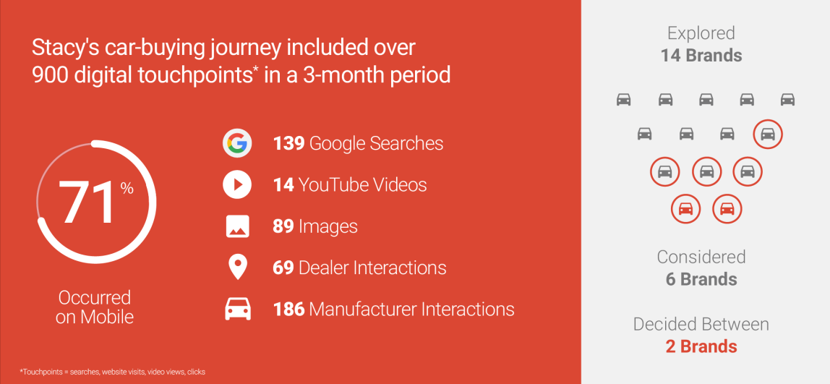

How People Buy Cars

Slide 3
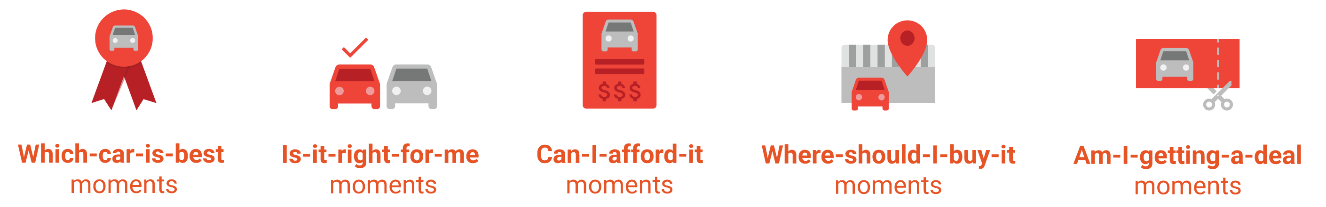
How People Buy Cars

Slide 4
Top SA Sites
 | Unique Visitors | Page Views
News24 | 6 166 741 | 62 858 399
IOL | 3 739 980 | 19 365 476
EWN | 3 526 706 | 24 879 097
Autotrader | 1 898 020 | 60 224 787
Cars | 1 484 482 | 58 642 034

Slide 5

Dealership Acquisitions Funnel
Dealer Sales Activity:
    2-3m monthly browsers
    120k F&I applications
    45k Financed Buyers – 70k total buyers
Aggregators
WebSite
Online
Digital Marketing
CRM
Showroom
DMS
F&I
Contracting
F&I Office

Slide 6
Dealership Acquisitions Funnel
Threats to the funnel:
    Massive inefficiency
    Burden of applications
    Disjointed processes – poor integration
    Private Banks
    Direct entrants
Aggregators
WebSite
Online
Digital Marketing
CRM
Showroom
DMS
F&I
Contracting
F&I Office

Slide 7
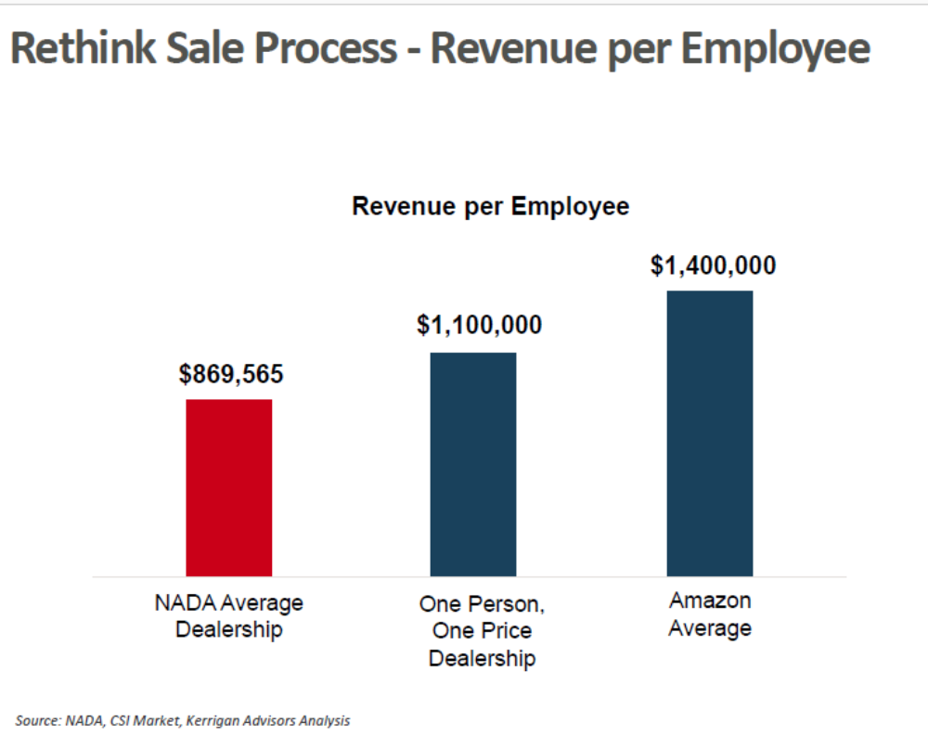
Rethink sale process – revenue per employee

Slide 8
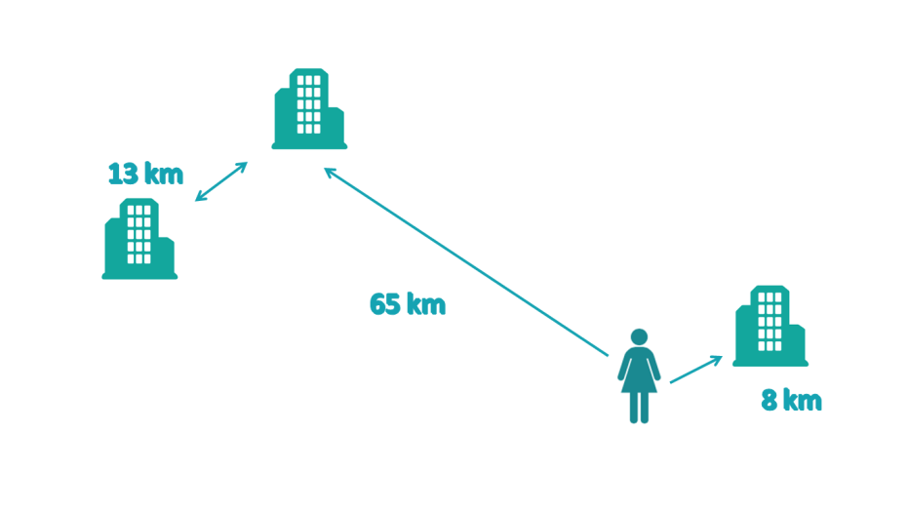
Dealership / Customer Distances
Subset of WesBank book
Customers / Dealers Gauteng Only
Customers Home Address only
8% applications - Out of province

Slide 9

Time on Floorplan
Weeks
Industry Average
Best Practice

Slide 10
Digital Marketing -
    Search Engine Optimisation
    Online ads
    Remarketing
    Content Marketing
    Social Media Marketing
    Marketing ROI
Aggregators
WebSite
Online
Digital Marketing
CRM
Showroom
DMS
F&I
Contracting
F&I Office

Slide 11





Digital Marketing Domains

Slide 12
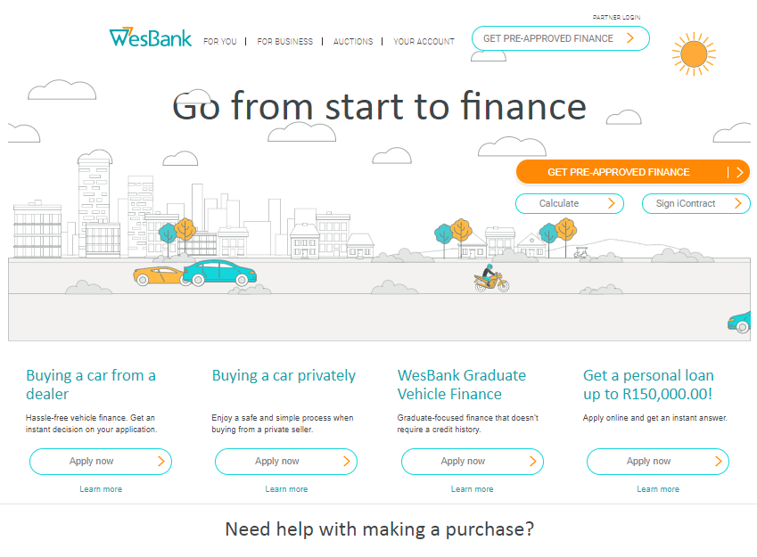
WesBank Pre-Approvals
Key Features:
  Can begin to guide the user on ‘approval’ from 5 data fields - ID, Email, Cell#, Income (Gross & Net);
  The assessment of risk is identical to WesBank but significant re-engineering of the scorecard gives
    ANY approvable deal for a given customer
    Counter Offer

Slide 13
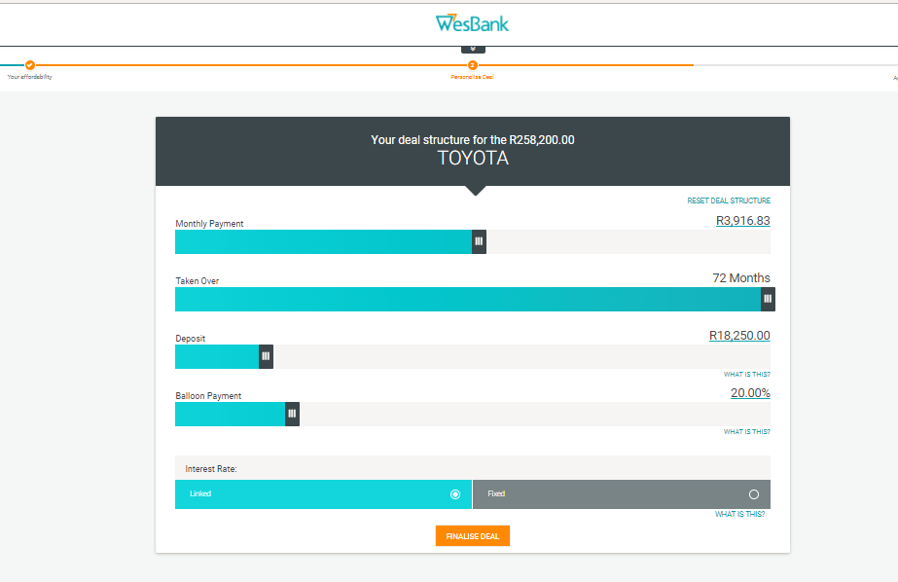
WesBank Pre-Approvals – aka Fasttrack

Slide 14
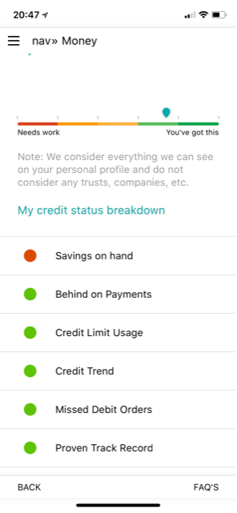
Scorecards as a Consumer Tool
Do you pay your current debt?
How much have you already?
Have much have you taken recently?
Do you pay your other commitments?
Track Record with debt?

Slide 15
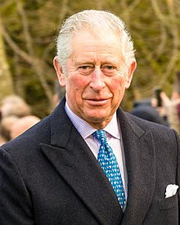
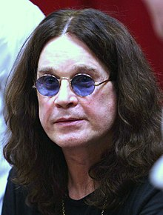
Scorecard vs Personality
Born: 1948
Segment: Upper income
Own property in Central London
Married twice

Slide 16
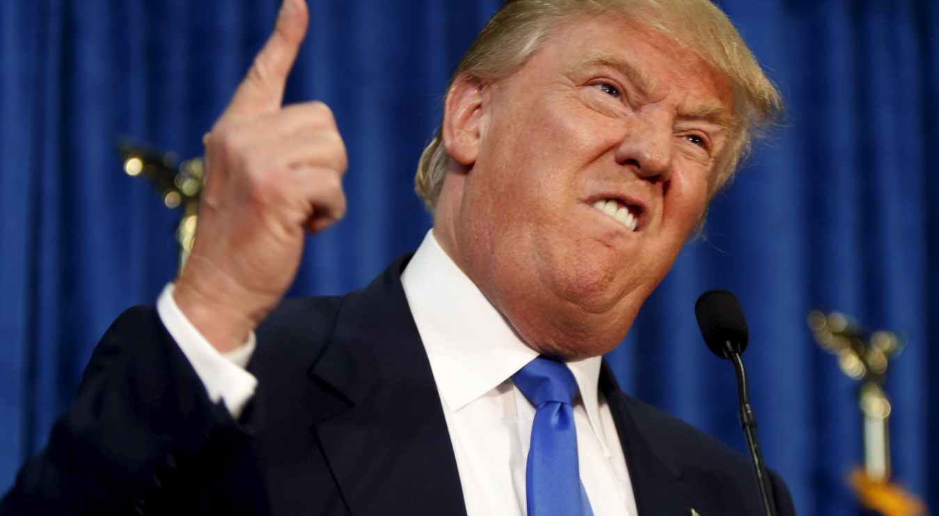
How did he win?

Slide 17
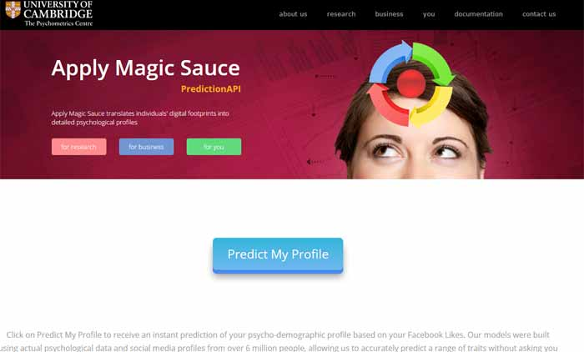


Science or Subterfuge?
50m

Slide 18
Big 5 Personality Traits
Openness to Experience Inventive/Curious to Consistent/Cautious
Conscientiousness Efficient/Organised to EasyGoing/Careless
Extraversion Outgoing/Energentic to Solidarity/Reserved
Agreeableness Friendly/Compassionate to Challenging / Detached
Neuroticism Sensitive/Nervous to Secure/Confident

Slide 19
Hyper Segmentation
…Pretty much every message that Trump put out was data-driven……... on the day of the third presidential debate between Trump and Clinton, Trump’s team tested 175,000 different ad variations for his arguments, in order to find the right versions above all via Facebook. The messages differed ………… in order to target the recipients in the optimal psychological way……..This fine-tuning reaches all the way down to the smallest groups……

Slide 20


