Slide 1



Systemic Risk Modelling and
Early Warning Systems
Conrad Beyers
Absa Chair in Actuarial Science
31 July 2018
Notes:
Funding

Slide 2
Disclaimer
Fair use of material
  Citations
  Links to material
The University of Pretoria hosts the Absa Chair in Actuarial Science – the views expressed here do not aim to represent any stance or viewpoint of Absa.

Slide 3
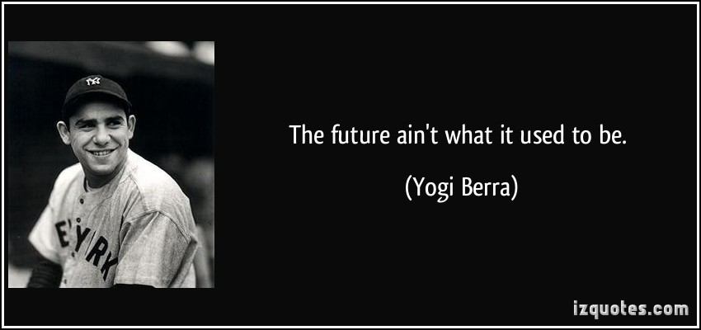

Slide 4


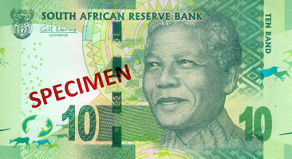

How safe is your money?
What is money, why valuable?
Trust
Notes:
Just a proxy – has value
Not gold backing it, nowhere to pick it up
Trust only
Central banks
Price stability
Financial stability

Slide 5
Overview
Systemic risk background
Modelling approaches
Early warning systems - illustration
Future research

Slide 6
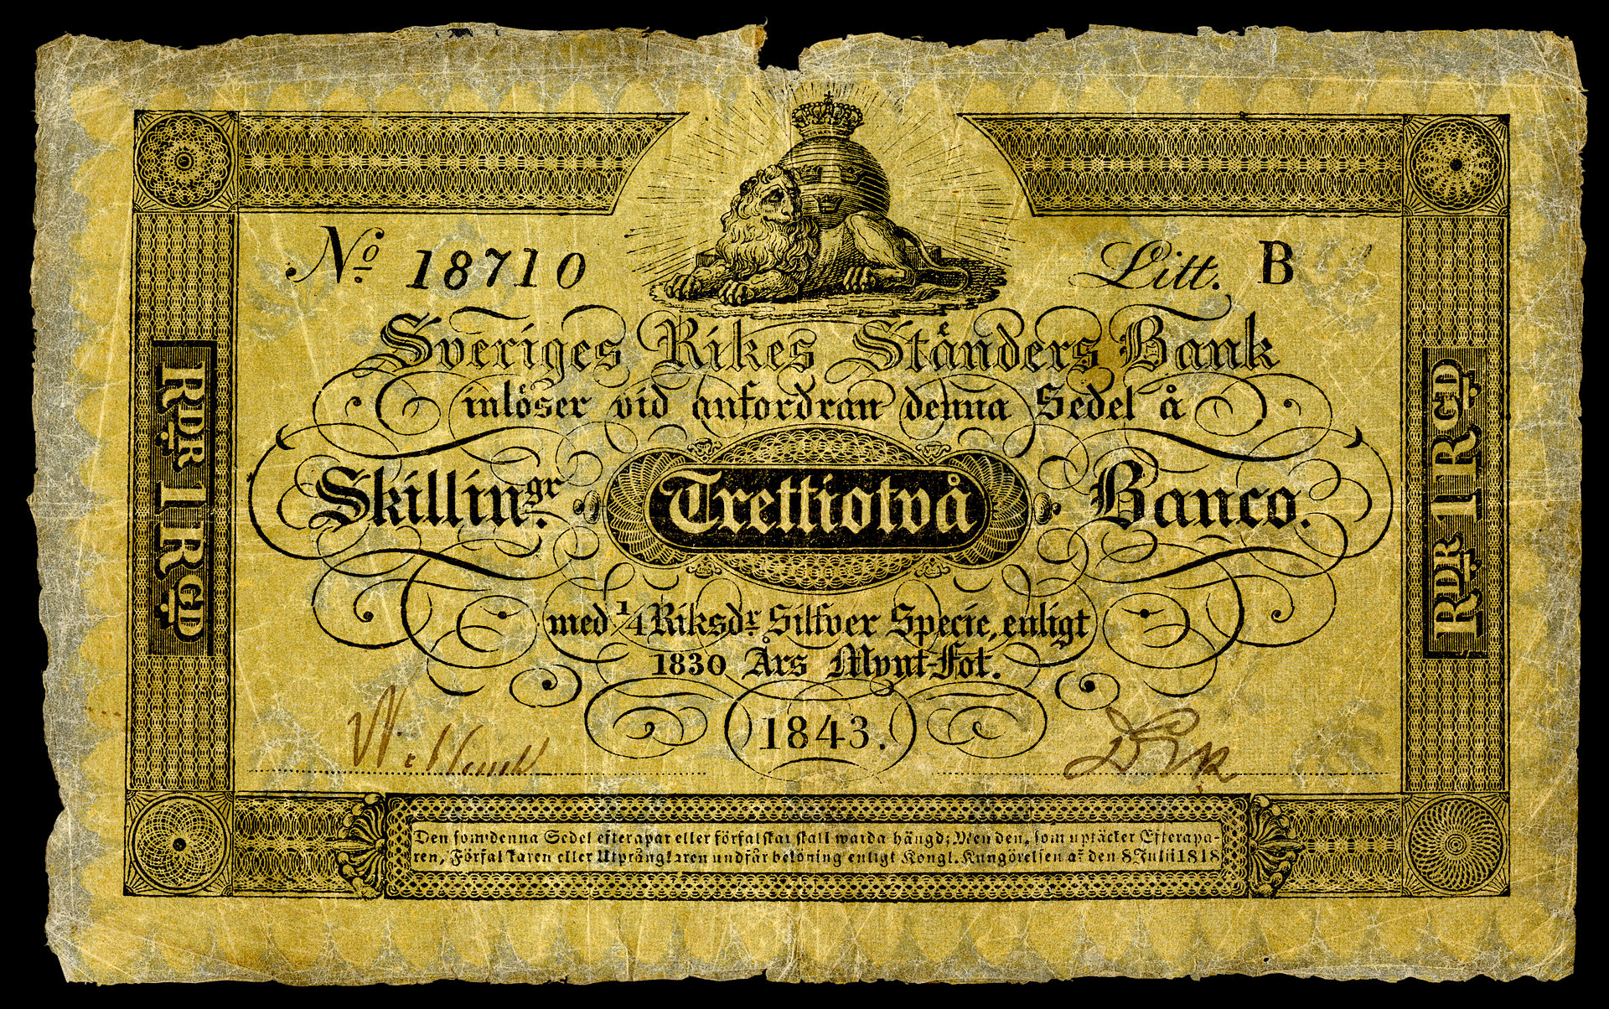
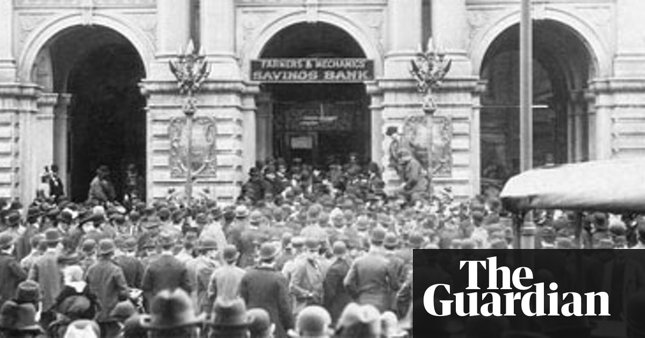
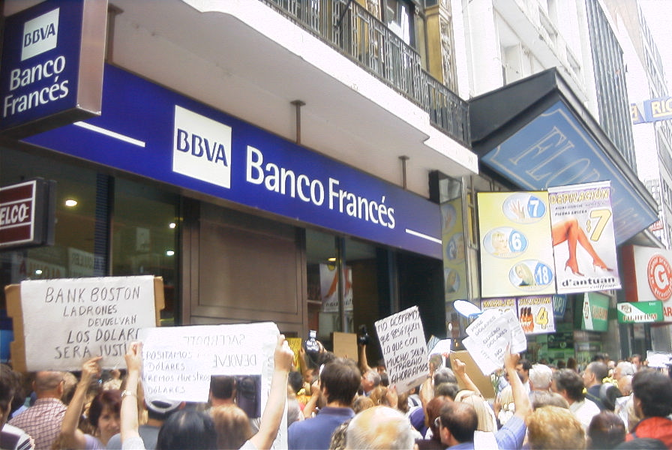
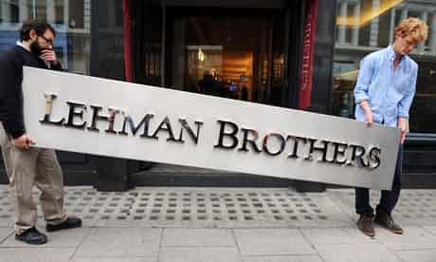
A history of lost trust
1660’s - Stockholm Banco
1907 - Bank Panic, US
Early 2000’s - Argentina

Slide 7

Systemic Banking Crises
Examples
USA alone: 540 banks have failed since October 1 2000¹. 516 of which closed between 2007 and 2015.
South Africa: African Bank collapse in 2014. Net loss R9.3bn in the fiscal year to September².
“Failed Bank List”, Federal Deposit Insurance Corporation, “https://www.fdic.gov/bank/individual/failed/banklist.html
“African Bank posts record R9.3bn loss,” Finance 24, http://www.fin24.com/Companies/Financial-Services/African-Bank-posts-record-R93bn-loss-20150611
7
Notes:
Examples:
Federal Deposit Insurance Corp list
African bank

Slide 8
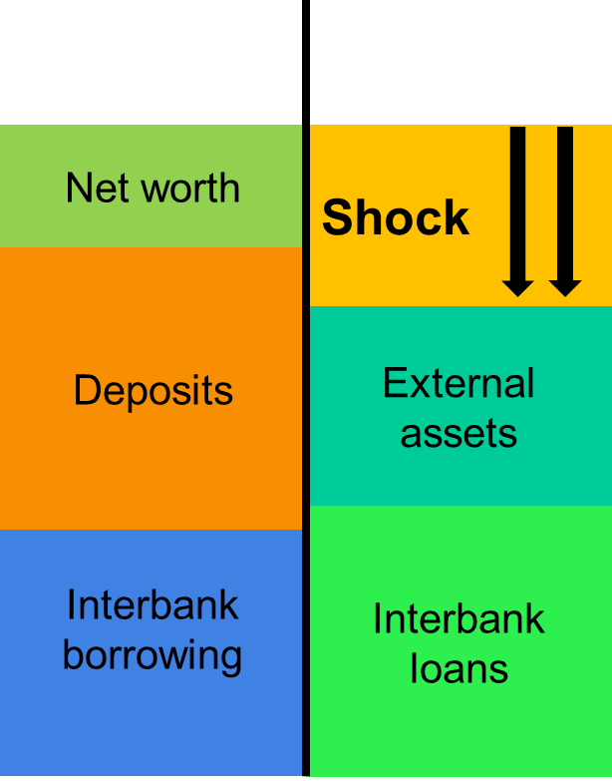
How may a crisis develop?
L
A
Shareholders, subordinated creditors take first hit
Recapitalisation required …
Other banks, bailouts
Initial shock
Trust meltdown
Funding dries up
Overreaction
Other indirect shocks
Feedback loops
Forced sales to generate funds
(stressed value)
Similar assets lose value for other banks
Notes:
Chain of events:
First bank experiences problems – short or long term (bad lending practices, disruption in target market … e.g. mining)
Shareholders, subordinated creditors absorb losses
Recapitalisation required – other banks, bailout etc
Liquidity strain
Forced sales of assets (lower price) – affect value of assets of other banks with same assets
Meltdown of trust in other banks. Downgrades etc
Credit dries up – expensive i.e. further strain in wider system
Bank runs, intervention etc.
Feedback loop

Slide 9
Major risks
International
South Africa

Slide 10


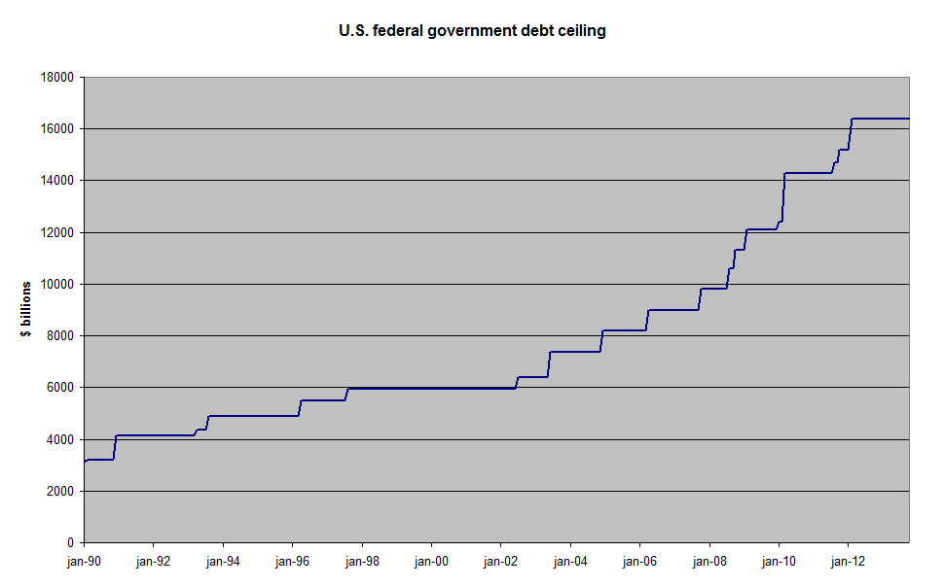
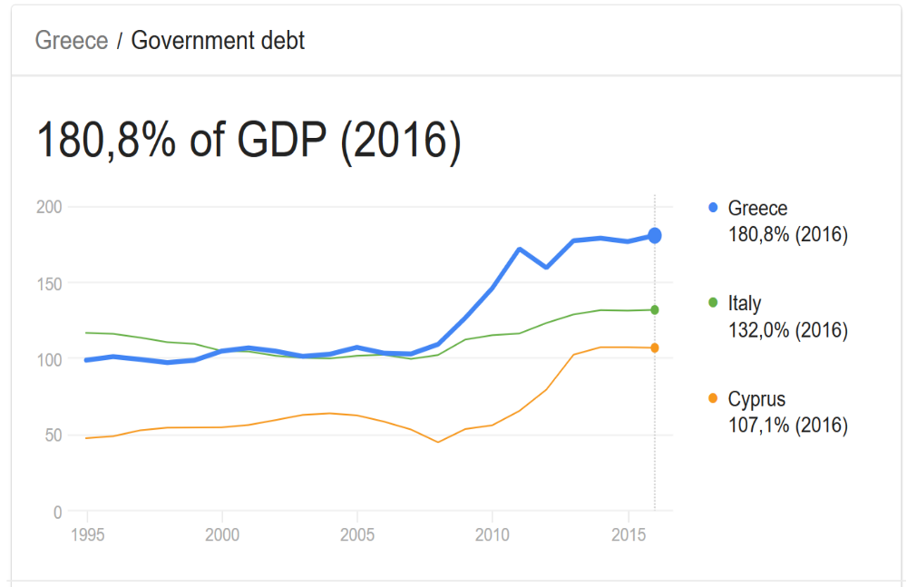
International risks: Payday

Slide 11

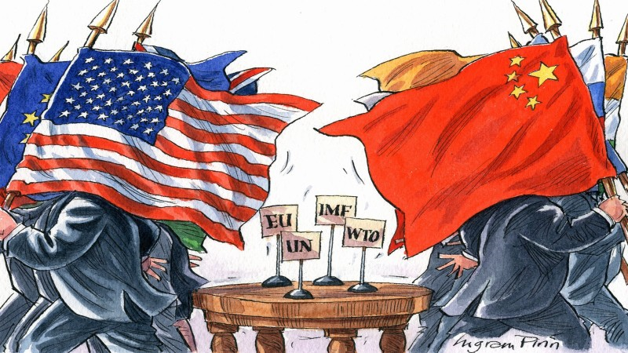
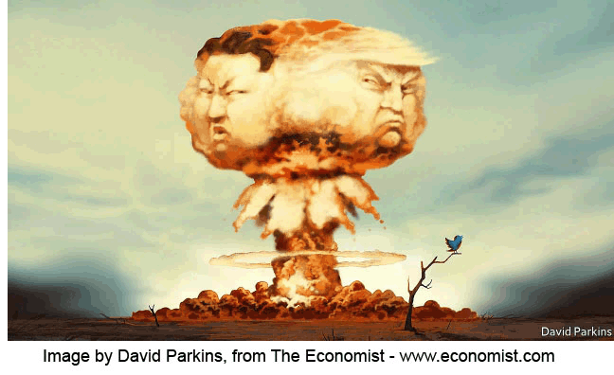
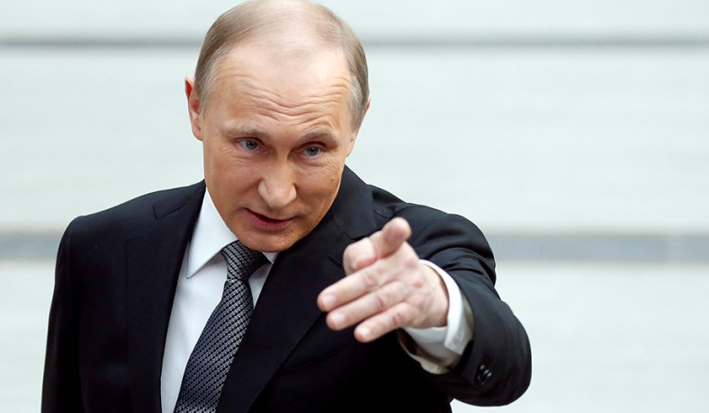
International risks: Conflict

Slide 12



International risks: Technology

Slide 13
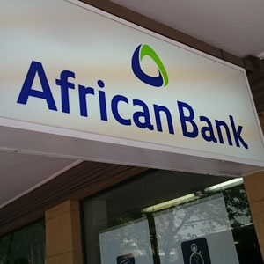


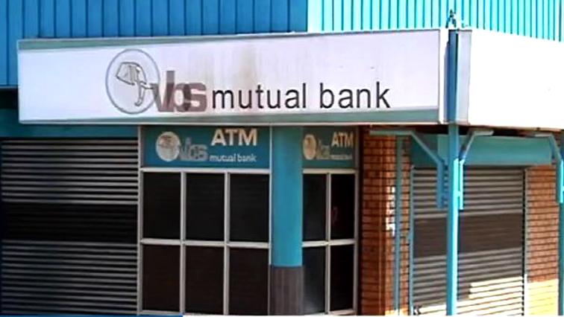
SA risks: Governance
Notes:
SARB Financial Stability Committee mentions these things

Slide 14
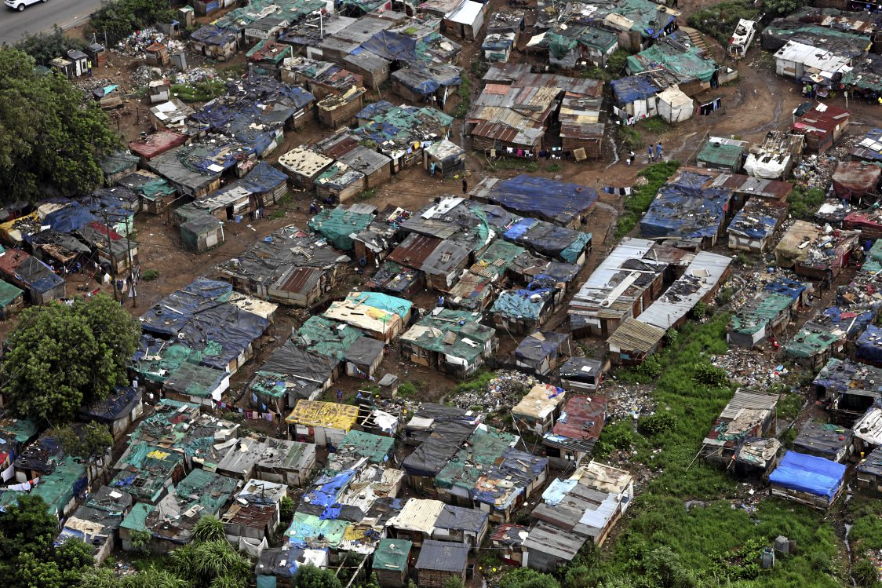
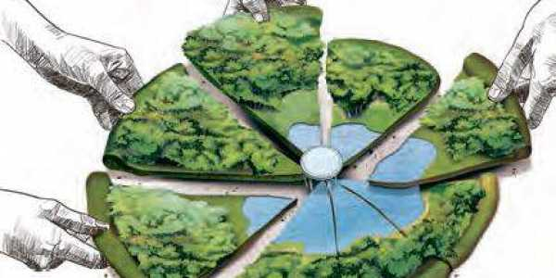

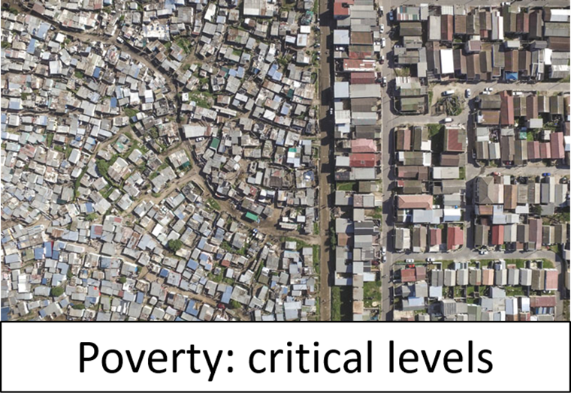
SA risks: Socio-economic
Notes:
SOE’s
Land

Slide 15

Risks
Fin. infrastructure
Macro-economic
Political risk
Regulatory

Slide 16
Modelling systemic risk

Slide 17

What to model, not to model?
Conditional stability
Notes:
Not wars
Not major political earthquakes

Slide 18
What to model, not to model?
With or without lender of last resort?
Model shocks or shock propagation?
Risk appetite?
Conceptual or real-world?
Notes:
Including central bank is like including insurance cover when pricing risk …

Slide 19
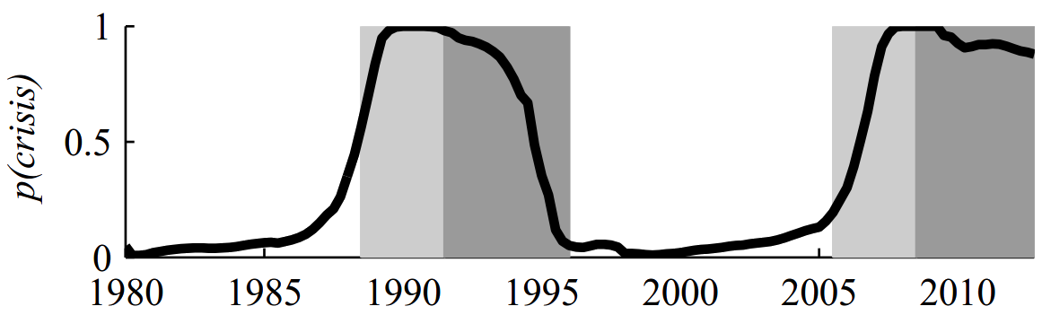
Ideal model – wouldn’t it be nice …
Pre-Crisis
Period
Crisis
Period
19
Notes:
NB-SLDS results for Finland:
Light Grey: Pre-crisis
Dark Grey: Crisis
Black Line: Probability
Our data tells us when the crisis period is. We can then extract the 3 year pre-crisis period data. This pre-crisis data is used to train the model. Hopefully, the model is then able to detect the pre-crisis period.
Note the leave-one-out cross validation approach for each country.

Slide 20
Modelling financial systems
Layers of complexity
Interconnected financial entities
Intervention
Banks
Insurers
Shadow sector
Macro-environment
Time evolution
Legal
Shocks
Notes:
Interactions between various subgroups – e.g. mining sector default has much wider impact …
“Clouds” of default – but “contagion” effects no less real
Shock on lenders.
Interaction between lenders (implied by borrower behaviour and lending practices)
Dissecting a specific type of shock … credit risk
Distinct, and in some respects more challenging, modelling problems.
This is a massive problem to tackle analytically. Needs to dissect and break down to it basic elements (similar to study of general systemic risk)
Brief example of a one aspect of the problem.

Slide 21
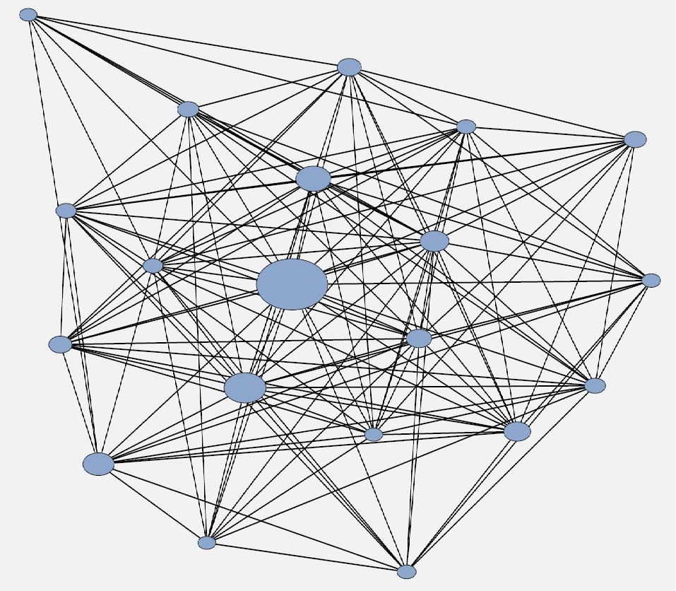
Approach 1: Bank networks and shock propagation (simulation-based)

Slide 22
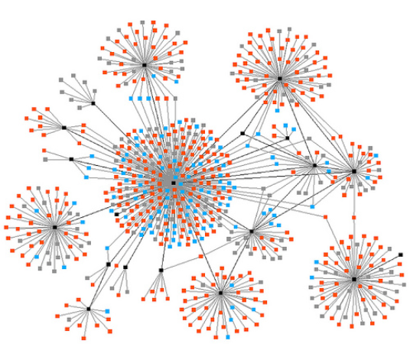
Approach 2: Analytical (network-of-networks)

Slide 23
Approach 3: Stress testing
Input data
UK public aggregate data
Top-down stress test model
UK – RAMSI
USA granular customer level data
USA – FED model
Analysis
Cross-check top-down & bottom up results
Determine future scenarios
Aggregate bottom-up stress test results
Bank 1
Bottom-up stress test submission
Bank 2
Bottom-up stress test submission
…
Bank 4
Bottom-up stress test submission
Bank 3
Bottom-up stress test submission
US & UK guidelines

Slide 24
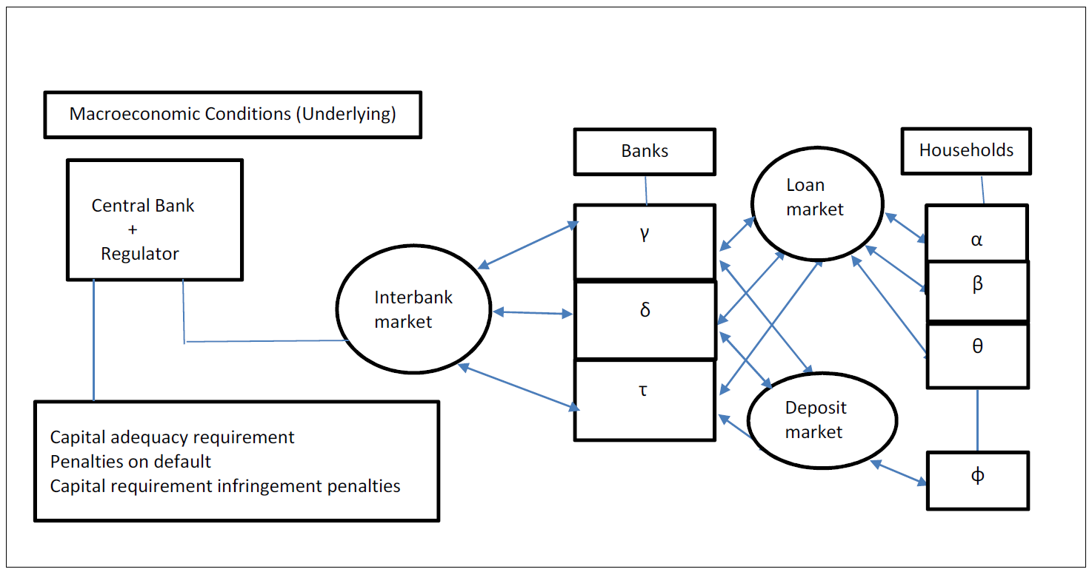
Approach 4: Financial market macro-economic models

Slide 25
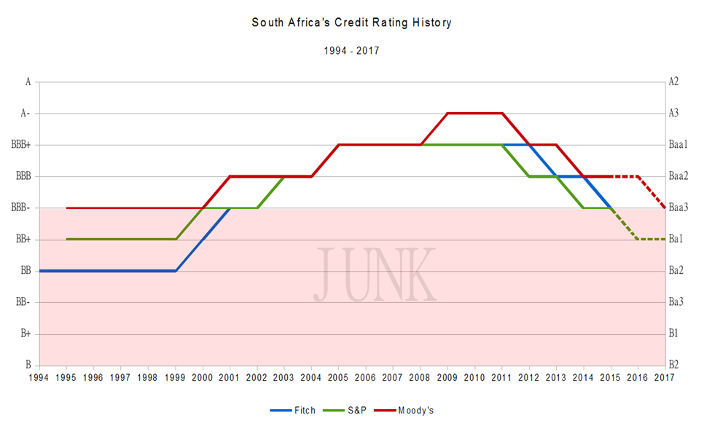
Approach 5: Credit ratings
Greece
EU, IMF
AID
Replicate ratings?
How good are the ratings?
Junk
RSA
Is US “risk-free”?
Alternative ratings?

Slide 26
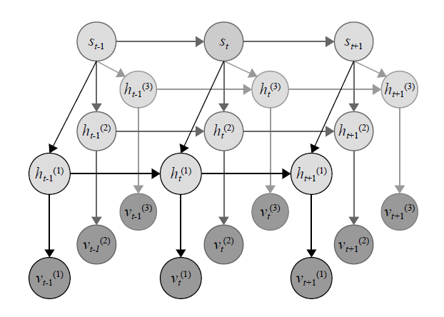
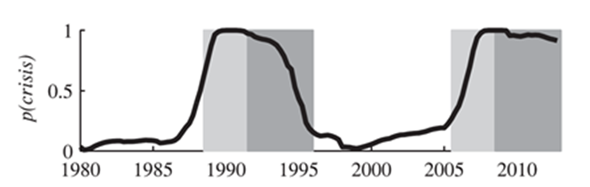
Approach 6: Early warning systems
Finland, 1990–1995 and 2008 crises

Slide 27
Early Warning Systems
Identify increased risk of banking crisis before it occurs

Slide 28
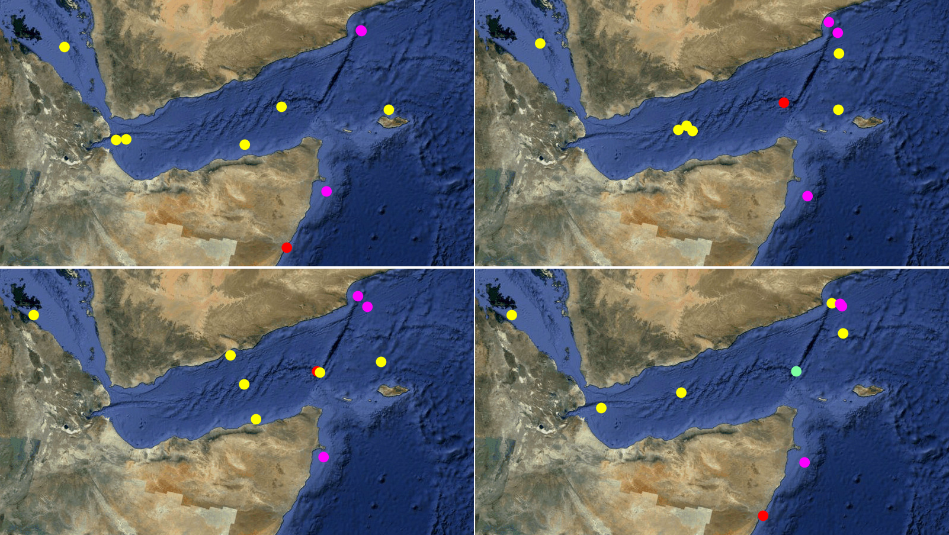
Maritime Piracy Project
Fishing
vessel
Transport vessel
Pirate vessel
(a)
(b)
Abandoned pirate vessel
Hijacked transport vessel
(c)
(d)
(a) Initialize, (b) Pirate Drift, (c) Pirate Attack, (d) Pirate returned.
Notes:
Simulation using the DBN in the MATLAB environment
RED = Pirate
YELLOW = Transport vessel
VIOLET = Fishing Vessel
TURQUOISE = Abandoned vessel
(a) => Initialize, (b) = Drift, (c) = Attack (LEAVE MOTHERSHIP IN SKIFFS), (d) = Returned with Hijacked vessel (note abandoned vessel)
Click on image to display gif simulation

Slide 29
Early Warning Systems
“Traditional” Methods for early warning of banking crises^{1,2}
‘Signals’ Approach (Thresholding)
Multivariable Logit Approach (Logistic regression)
(these models are “static” – does not identify patterns to provide for the dynamics in the system)
E. P. Davis and D. Karim, “Comparing early warning systems for banking crises,” Journal of Financial Stability, vol. 4, no. 2, pp. 89 – 120, 2008.
“Cross-country empirical studies of systemic bank distress: a survey,” National Institute Economic Review, Vol. 192, no. 1, pp 68-83, 2005.
29
Notes:
Current methods:
Explain each later
Signals approach – thresholding
Logit approach – logistic regression

Slide 30
Why a dynamic model?
?
Notes:
2/8 shapes are blue squares = 25%
6/8 shapes are green circles = 75%

Slide 31
Our Approach
Use a dynamic Bayesian network (DBN) to model the temporal dynamics of variables and infer the probability of a crisis.
Pros:
  Models temporal dynamics of the system.
  Infers probability of a crisis which provides a “threat level” indication.
Cons:
  More complex
Notes:
Proposed approach
Dynamic model of variables or features
Based on the model, infer probability of immanent crises
Pro: dynamical and not binary
Con: More complex, but this is a complex problem…

Slide 32

Model Evolution:
Linear Dynamic System
Variables:
h_{t}: State vector
v_{t}: Measurement vector
h_{t-1}
h_{t}
h_{t+1}
v_{t-1}
v_{t}
v_{t+1}
Notes:
The LDS is a linear state space model that models the dynamics of a system.
Applications: Control systems, Financial time series modelling, etc

Slide 33
Model Evolution
Switching Linear Dynamic System
Variables:
h_{t}: State vector
v_{t}: Measurement vector
s_{t}: Switching State vector
s_{t-1}
s_{t}
s_{t+1}
h_{t-1}
h_{t}
h_{t+1}
v_{t-1}
v_{t}
v_{t+1}
Notes:
SLDS includes state st to allow for discontinuous state changes
Each st allows for a different LDS
Let st have two states; tranquil and crisis.
Each state has a LDS, one LDS models dynamics of a tranquil period, the other models dynamics of a crisis period
Problem: Multiple variables and missing data

Slide 34
Data
A dataset describing developed European economies with long time series is used¹.
Variables include: house prices, mortgages, mortgages to GDP, household loans, household loans to GDP, private loans, private loans to GDP, consumer price index, GDP, current account surplus to GDP, and loans to deposits.
A total of 19 systemic banking crises are included in the dataset.
Laina, P., Nyholm, J., Sarlin, 2015. "Leading indicators of systemic banking crises: Finland in a panel of {EU} countries". Review of Financial Economics 24, 18 – 35.
Notes:
European economies with lots of data
Excluded developing countries (different markets)
Various variables.
A total of 19 crises in total (which is few)

Slide 35
Desired Outcome
NB-SLDS
Model
Prediction
Pre-Crisis
Period
Crisis
Period
35
Notes:
NB-SLDS results for Finland:
Light Grey: Pre-crisis
Dark Grey: Crisis
Black Line: Probability
Our data tells us when the crisis period is. We can then extract the 3 year pre-crisis period data. This pre-crisis data is used to train the model. Hopefully, the model is then able to detect the pre-crisis period.
Note the leave-one-out cross validation approach for each country.

Slide 36
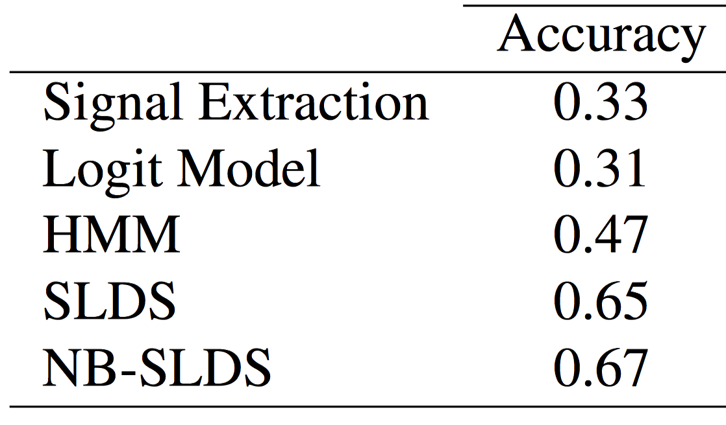
Results Comparison:
Average crisis predictability results over all countries.
(Only evaluate pre-crisis period)
Notes:
Pre-crisis only detection ability. That is, only detecting the light grey region from the earlier slide.
This is important as it indicates that the Signal extraction and Logit models are able to detect crises well, but not predict them.
Signal and logit models perform very poorly at predicting a crisis.
They did much better before because they were good at detecting tranquil regimes and actual crisis regimes, but not the pre-crisis regimes.
The NB-SLDS and SLDS both do better. (Note that these models are similar)

Slide 37
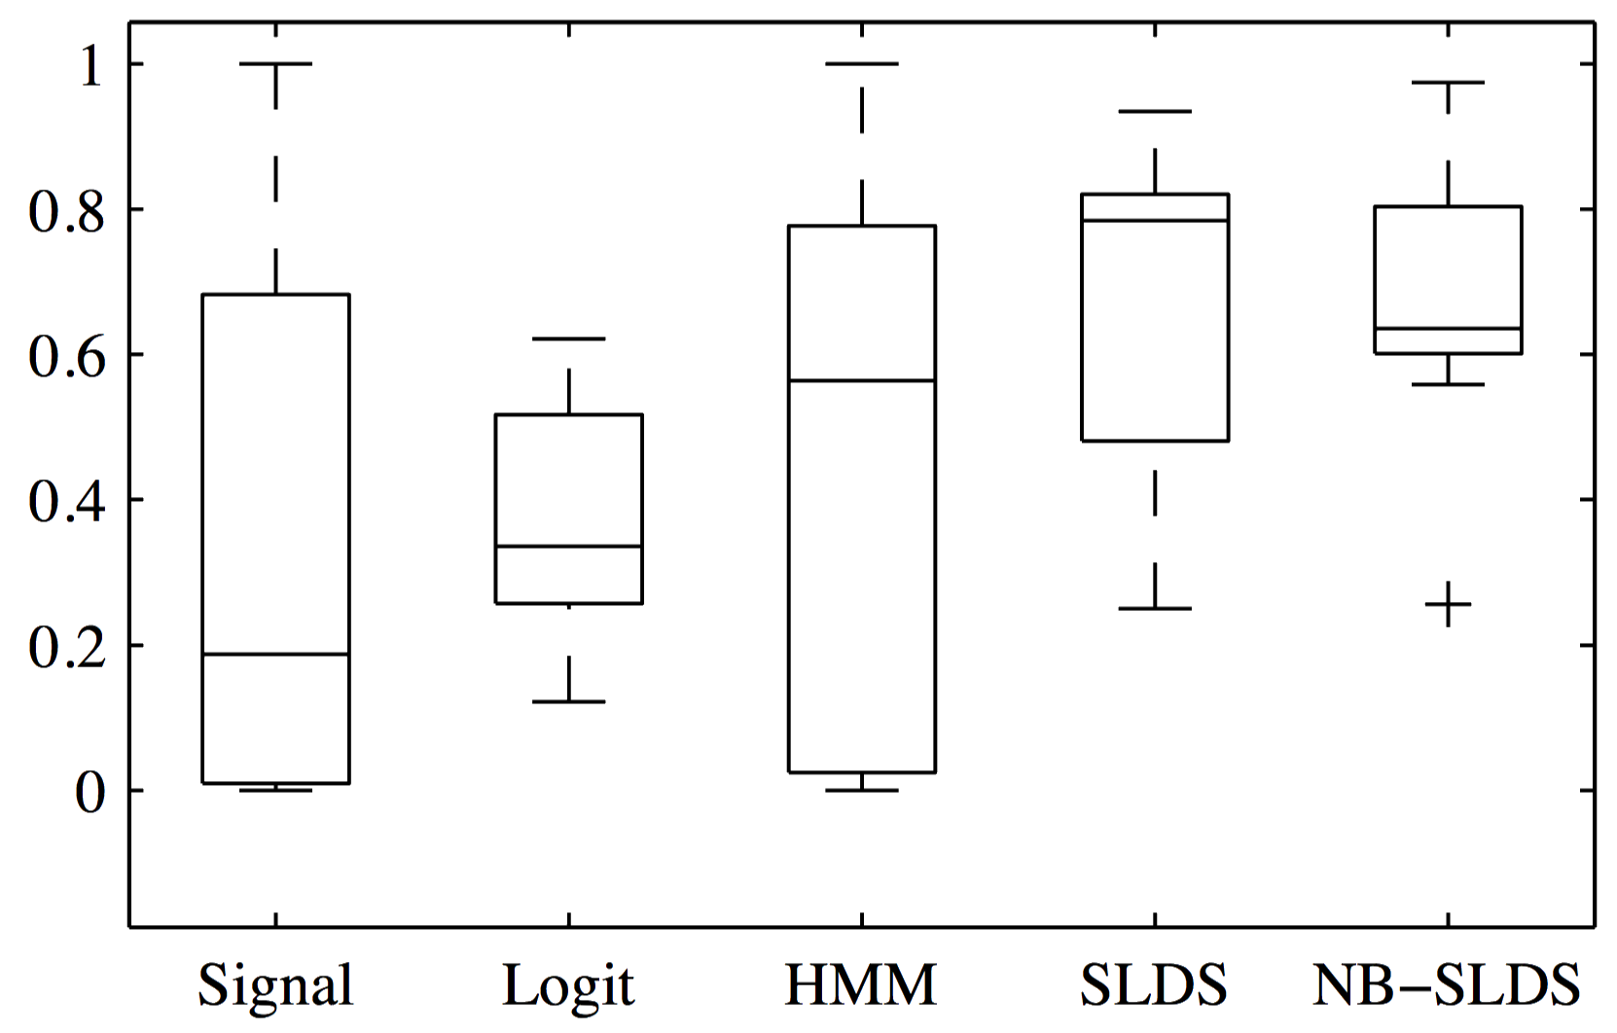
Results Comparison:
Box-Whisker Plot for crisis predictability accuracy: The ideal method has ‘high values’ with ‘smaller’ boxes.
Notes:
The SLDS however has a every nigh median.
The NB-SLDS model however has small box in a region high probability (ideal)
Most of the values fall within that range of probability (60-80%).
That is: 60-80% chance of predicting a crisis before it occurs!

Slide 38
Future research

Slide 39
EWS Development
Connect pieces of the puzzle
(macro model)
Risk indices or ratings
Risk lab

Slide 40
Collaborate
Regulators
Industry – individual and organised
Africa

Slide 41
Thank you
conrad.beyers@up.ac.za

Slide 42
Appendix

Slide 43
References:
Joel Janek Dabrowski, Conrad Beyers, Johan Pieter de Villiers, “Systemic banking crisis early warning systems using dynamic Bayesian networks”, Expert Systems with Applications, Volume 62, 2016, Pages 225-242, ISSN 0957-4174, https://doi.org/10.1016/j.eswa.2016.06.024.
By National Museum of American History - Image by Godot13, Public Domain, https://commons.wikimedia.org/w/index.php?curid=40320635
Investing News https://investingnews.com/daily/resource-investing/precious-metals-investing/gold-investing/gold-price-rises-amidst-trade-tensions-with-china/
The Guardian https://www.theguardian.com/money/2007/sep/19/business
Wikimedia commons https://commons.wikimedia.org/wiki/File:Bitcoin.svg
Triposo https://www.triposo.com/poi/W__27343865
By National Museum of American History - Image by Godot13, Public Domain, https://commons.wikimedia.org/w/index.php?curid=40320635
Notes:
Publications

Slide 44
MartinD - Own work, CC BY-SA 3.0, https://commons.wikimedia.org/w/index.php?curid=29025528
Policy perspectives https://policy-perspectives.org/2017/11/14/the-argentine-financial-crisis-causes-and-lessons-learned/
The Guardian https://www.theguardian.com/commentisfree/cifamerica/2011/dec/12/lehman-brothers-bankrupt
Waking Times http://www.wakingtimes.com/2018/04/19/world-debt-is-now-an-insane-164-trillion-but-who-exactly-do-we-owe/
ExtraNewsFeed https://extranewsfeed.com/why-is-donald-trump-so-often-angry-df522a7bb61a
NewsWeek https://www.newsweek.com/donald-trump-angry-temper-white-house-impeachment-jeff-sessions-russia-622481
National Review https://www.nationalreview.com/2016/09/donald-trump-vladimir-putin-bad-model/
Notes:
Publications

Slide 45
MartinD - Own work, CC BY-SA 3.0, https://commons.wikimedia.org/w/index.php?curid=29025528
The Actuary http://www.theactuary.com/news/2017/01/6-million-victims-of-financial-fraud-in-the-uk/
Money Mover https://www.moneymover.com/insights/anti-money-laundering-minimising-risks-electronic-identification/
The Citizen https://citizen.co.za/news/south-africa/1974527/vbs-mutual-bank-retail-depositors-to-get-access-to-their-money/
Fin24 https://www.fin24.com/Companies/Financial-Services/sp-raises-african-bank-national-rating-20180703
Business Live https://www.businesslive.co.za/bd/national/2017-08-22-more-than-half-of-sas-population-is-still-living-in-poverty/
Paul4Innovation https://paul4innovating.com/2016/10/03/the-new-innovation-need-organizing-within-a-networks-of-collaborators/network-of-networks/
Notes:
Publications

Slide 46
Signals Approach
Approach:
Variable values 24 months prior to a crisis are compared with the values during “tranquil” times.
A variable signals a crisis if it crosses a particular threshold.
Drawbacks:
Each variable is considered in isolation
Information from each indicator is not aggregated
Thresholding does not provide any indication of the severity of the crisis.
46
Notes:
Approach = Thresholding
Drawbacks:
Variables in isolation
Info is not grouped
Thresholding – no severity

Slide 47
Logit Model Approach
Approach:
The probability that a crisis occurs is assumed to be a function of a vector of explanatory variables.
A logit model is fitted to the data for evaluating the probability of a crisis (logistic regression).
Drawbacks:
Over-generalizes each class.
Identifying a crisis is “too late”.
Does not consider dynamics.
47
Notes:
Approach = Logistic regression
Drawbacks
Over generalised
When the crisis has hit its too late
Temporal dynamics

Slide 48
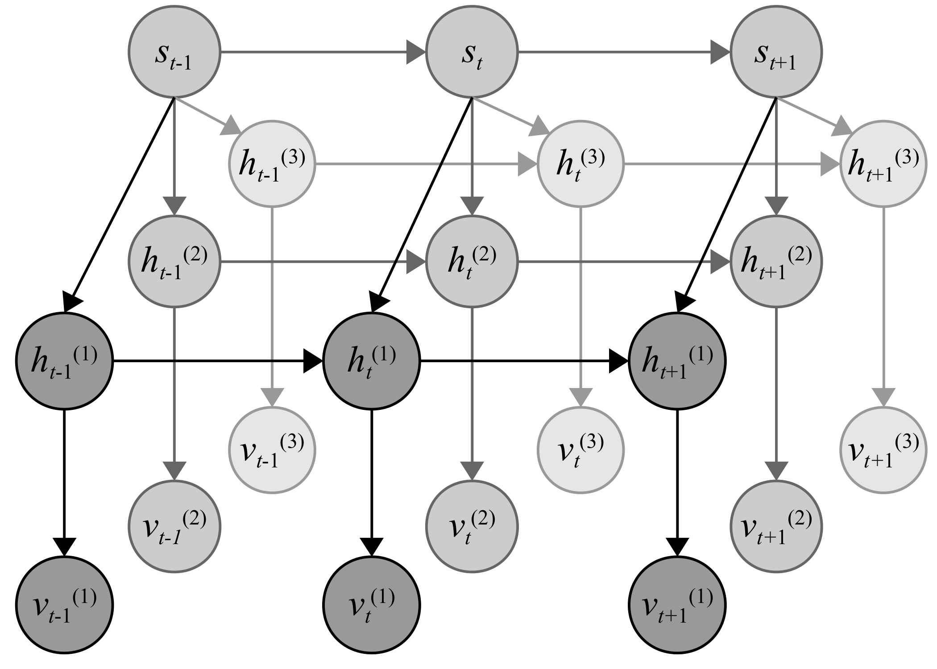
Proposed Model
48
Notes:
Naïve Bayes Switching Linear Dynamic System
Several LDSs converge to a single switching state
Each LDS models a variable/dataset
Variables: GDP, interest rate, Bank to capital assets ratio, net foreign assets
S_t => crisis/ non crisis

Slide 49
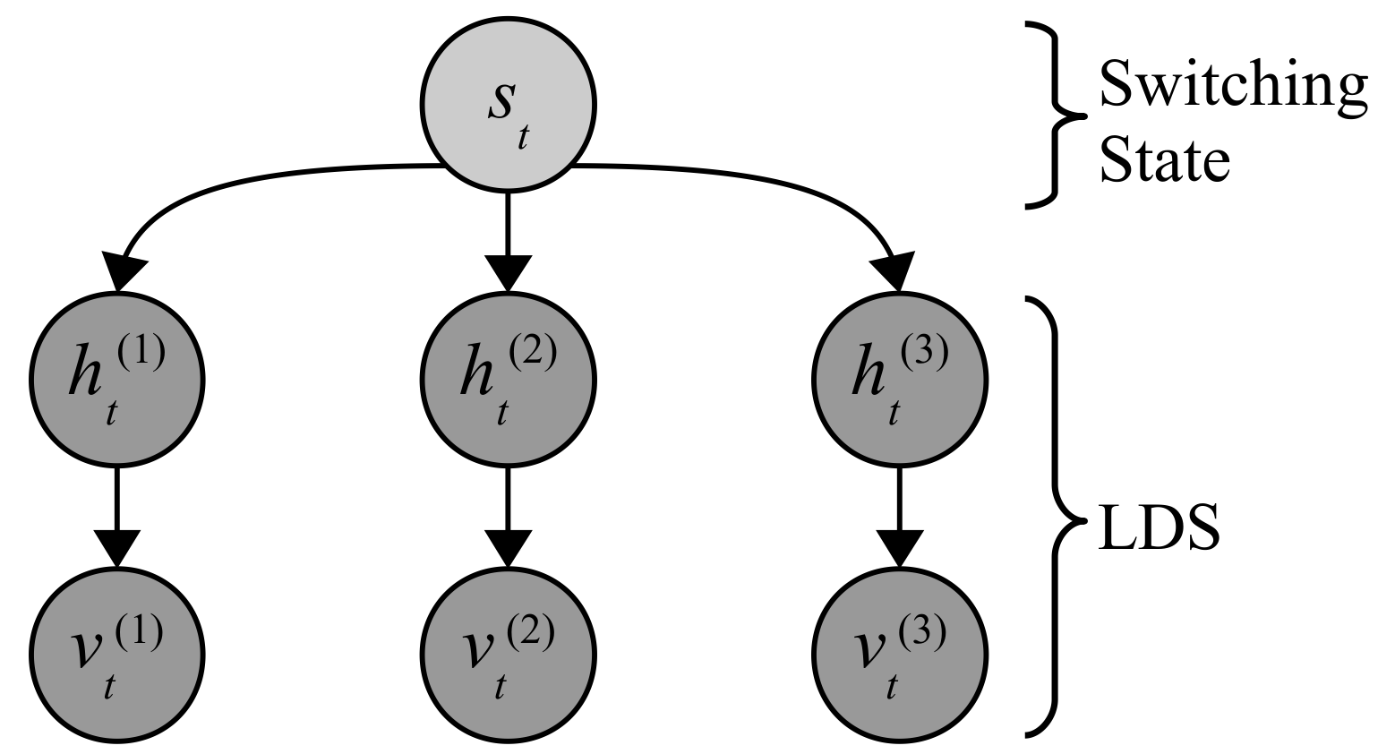
Proposed Model at time t
49
Notes:
Model at time t
Naïve Bayes structure
Idea:
At each time, what is the probability of a crisis

Slide 50
Approach
Given variables and crises periods.
Define pre-crises periods the 3 year period leading to the crisis.
Given a set of models: Logit model, Signals Model, Hidden Markov Model, SLDS, and NB-SLDS.
Leave-one-out cross validation:
For each model:
  For each country:
    Train the model on all other country data (leave referenced country out).
    Try predict tranquil, pre-crises, and crises periods for the referenced country.
    Report the performance of the model.
Compare average performance of models
Notes:
Leave one out cross validation – Leave out a country
Describe performance made more clear…

Slide 51
Performance Measures
Accuracy describes the probability of correctly classifying a crisis.
Recall is a sensitivity measure. It is a measure of the fraction crises detected.
Precision is a conﬁdence measure. It is a measure of the fraction of crisis detections that are actually crises.
F-score is the harmonic mean between the precision and recall.
Notes:
Accuracy, recall, precision and F-Score are used for evaluating the model

Slide 52
Performance Measures
True Negatives (TN)
False
Positives
(FP)
False
Negatives
(FN)
True Positives (TP)
(Correct Prediction)
Predicted Crises
True Crises
+
Accuracy = , Recall = , Precision =
Notes:
Venn diagram:
Violet circle: Predicted crises
Turquoise Circle: True crises
Recall is the correct prediction / Predicted Crises
Precision is the correct prediction / True Crises
Accuracy: ratio of t total correctly predicted crises + correctly predicted tranquil regimes over the entire possible set of outcomes.
Accuracy: relative frequency/probability of correct prediction

Slide 53
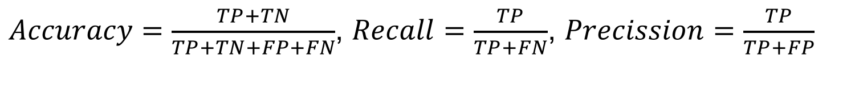
Performance Measures
True Negatives (TN)
False
Positives
(FP)
False
Negatives
(FN)
True Positives (TP)
(Correct Prediction)
Predicted Crises
True Crises
$Accuracy=\frac{TP+TN}{TP+TN+FP+FN}$, $Recall=\frac{TP}{TP+FN}$, $Precission=\frac{TP}{TP+FP}$
Notes:
Venn diagram:
Accuracy is the correct prediction / (True Crises and Predicted crises)
Recall is the correct prediction / Predicted Crises
Precision is the correct prediction / True Crises

Slide 54
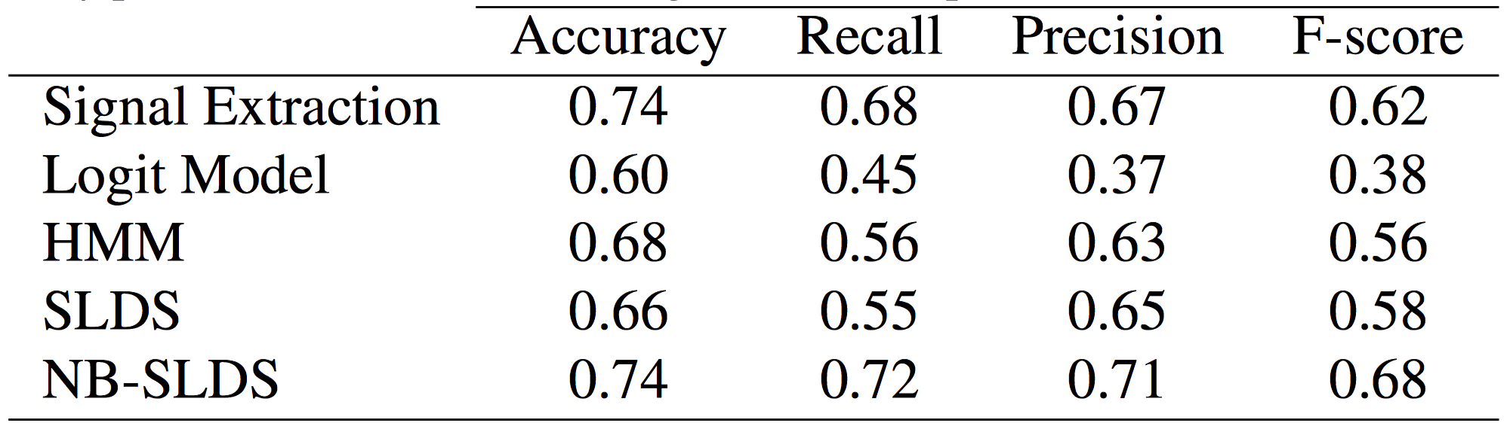
Comparison Results:
Average regime detection results over all countries.
(Computed over the complete data sequence of the best performing features.)
Notes:
Overall results for the models detecting pre-crisis and crisis periods (both light grey and dark grey regions from previous slide)
Accuracy is pretty good for all the models.
The logit does poorly
The low recall and precision values for the logit model indicate that it does not detect crises very well.
The SLDS has a low recall value, meaning that it has a high number of false negatives – meaning it misses crises.

Slide 55
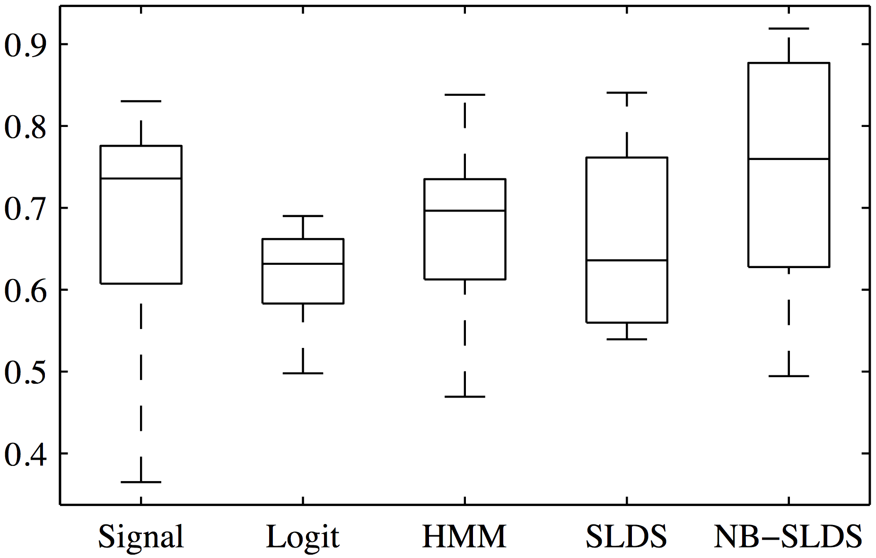
Comparison Results:
Box-Whisker Plot for regime detection accuracy: The ideal method has ‘high values’ with ‘smaller’ boxes.
Notes:
Box whisker plot for the crisis prediction evaluation.
The central mark is the median. The top and bottom edges of the box are the 25th and 75th percentiles respectively. The whiskers extend to the most extreme data points. Outliers are plotted individually with the + symbol.
The NB-SLDS does have the highest results, but its box is large indicating high variability.
The low percentile is still however very good compared to the other models
The NB-SLDS model does well, but its box is large.
Signal Extraction model does surprisingly well. Perhaps it is the best method given its simplicity?
This is where it gets interesting…

Slide 56
Lower Recall, Higher Precision
True Negatives (TN)
FN
FP
True Positives (TP)
(Correct Prediction)
Predicted Crises
True Crises
+
Accuracy = , Recall = , Precision =
Notes:
The precision is high => crisis predictions are mostly correct
But the recall is low => there are predictions missing from the true crises

Slide 57
Comparison Results:
Average crisis predictability results over all countries.
(Only evaluate pre-crisis period)
Notes:
Pre-crisis only detection ability. That is, only detecting the light grey region from the earlier slide.
This is important as it indicates that the Signal extraction and Logit models are able to detect crises well, but not predict them.
Signal and logit models perform very poorly at predicting a crisis.
They did much better before because they were good at detecting tranquil regimes and actual crisis regimes, but not the pre-crisis regimes.
The NB-SLDS and SLDS both do better. (Note that these models are similar)

Slide 58
Comparison Results:
Box-Whisper Plot for crisis predictability accuracy: The ideal method has ‘high values’ with ‘smaller’ boxes.
Notes:
The SLDS however has a every nigh median.
The NB-SLDS model however has small box in a region high probability (ideal)
Most of the values fall within that range of probability (60-80%).
That is: 60-80% chance of predicting a crisis before it occurs!

