Slide 1

Quantifying the impact of volatility on sustainable incomes of living annuities
Author: Jaco van Tonder
Date: August 2018

Slide 2
Content
Background
Modelling living annuity behavior – model summary
Relationship between real return, volatility and sustainable income
Application of these relationships
Notes:
Welcome to this short introductions to Moodle. The objective of this presentation is to provide every student with a short but helpful overview of Moodle as well as to share some tips and tools on how to use Moodle and avoid unnecessary frustrations. Lastly we will provide some information on where to find additional help when you get stuck in Moodle!
This presentation will cover – What is Moodle?; How to log-on to Moodle; Moodle courses and structure and navigation in Moodle as well a short overview of some key Moodle functions that you may encounter in the course of your studies.

Slide 3

Background
Debates focus on living annuity vs conventional annuities
Challenges with existing living annuities
Risky drawdowns
Conservative portfolios
Sequencing risk
50% of large LA starting incomes>5%*
Agv Equity exposure = 40%*
Balanced funds = CPI + 7%?
* Data from Investec IMS living annuity book
Notes:
What is Moodle?
The Actuarial society set out to improve the way course information and activities are coordinated and presented to students.
For this purpose the Moodle platform was selected and implemented in 2015 as ASSA’s Learning management system.
Moodle as a Learning Management System that is web based and allow ASSA to administer and track courses online. This platform is accessible to registered student via the web. It will be used to receive relevant course material and documentation as well as to manage submissions of assignments and other documentation for example all Work Based Learning forms and documents. The Moodle platform also allows students to collaborate and take part in other course activities such as discussion forums or the peer review of assignments.
Moodle has been used by the F200 Course Leaders over the last couple of years. In 2015 we started to implement all other courses on Moodle with a staggered roll-out plan over 3 years for all ASSA courses.
2016 will see the full implementation of all ASSA education courses on Moodle that are not currently already active on the system.
These and other Moodle functions will be discussed further on in this presentation.

Slide 4
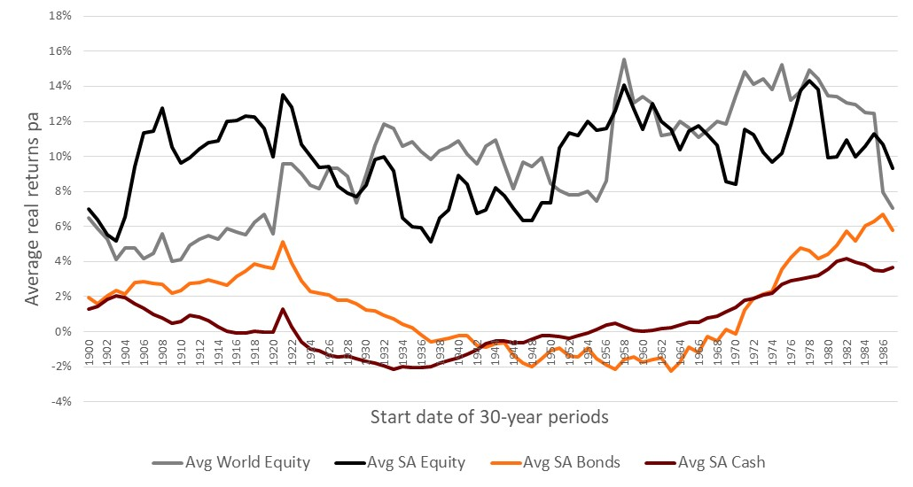
Sequencing risk in practice
Dimson/Marsh/Staunton dataset
Notes:
What is Moodle?
The Actuarial society set out to improve the way course information and activities are coordinated and presented to students.
For this purpose the Moodle platform was selected and implemented in 2015 as ASSA’s Learning management system.
Moodle as a Learning Management System that is web based and allow ASSA to administer and track courses online. This platform is accessible to registered student via the web. It will be used to receive relevant course material and documentation as well as to manage submissions of assignments and other documentation for example all Work Based Learning forms and documents. The Moodle platform also allows students to collaborate and take part in other course activities such as discussion forums or the peer review of assignments.
Moodle has been used by the F200 Course Leaders over the last couple of years. In 2015 we started to implement all other courses on Moodle with a staggered roll-out plan over 3 years for all ASSA courses.
2016 will see the full implementation of all ASSA education courses on Moodle that are not currently already active on the system.
These and other Moodle functions will be discussed further on in this presentation.

Slide 5
Pensioner drawdown puzzle
Income keeping pace
with inflation
Risks
Investment
Mortality
S.O.R
Behavioral risks
Notes:
Moodle log-on:
Use this website address to access the Moodle site. It might be a good idea to create this link as a favorite or shortcut in your internet browser for easy access to Moodle every time.
Moodle is a secure system where all user activities can be tracked. You will receive username and default password information from the society via email once you’ve successfully registered for a course. Use this information to log-on to Moodle for the 1st time.
After your 1st log-on the system will ask you to change your password to ensure that only you can access your account.
This new password must adhere to the following conditions:
It must be at least 8 characters long
It must contain at least 1 uppercase letter
It must contain at least 1 special character like a question mark or hash sign etc.
Only passwords meeting these conditions will be accepted by the system.
4. Tip – tick the “remember username” box on the login screen for the system to remember your username and password details for easy access every time.
If you register for additional courses you will still use the same username and password to access all your courses in Moodle.

Slide 6
Annuity modelling
Product parameters
Investment engine
  Fixed 30 year terms
  Annual returns/incomes assumed
  Product/advice fee – 1% pa
  Fund manager fee – alpha
  Dimson/Marsh/Staunton dataset
  SA Equity/Foreign Equity/SA Bonds/SA Cash
  30 year rolling terms
  Return series stepped in years
  Some results also tested with simple normal distribution
  Optimised portfolios for every income level
Income strategy
Defining success
  Tested variety of strategies
  CPI increases
  Income increases as function of net investment return after income
  Tested annuity hitting income caps inside 30 years
  Tested whether purchasing power of annuity at any stage dips below 50% of initial purchasing power
Notes:
Moodle log-on:
Use this website address to access the Moodle site. It might be a good idea to create this link as a favorite or shortcut in your internet browser for easy access to Moodle every time.
Moodle is a secure system where all user activities can be tracked. You will receive username and default password information from the society via email once you’ve successfully registered for a course. Use this information to log-on to Moodle for the 1st time.
After your 1st log-on the system will ask you to change your password to ensure that only you can access your account.
This new password must adhere to the following conditions:
It must be at least 8 characters long
It must contain at least 1 uppercase letter
It must contain at least 1 special character like a question mark or hash sign etc.
Only passwords meeting these conditions will be accepted by the system.
4. Tip – tick the “remember username” box on the login screen for the system to remember your username and password details for easy access every time.
If you register for additional courses you will still use the same username and password to access all your courses in Moodle.

Slide 7
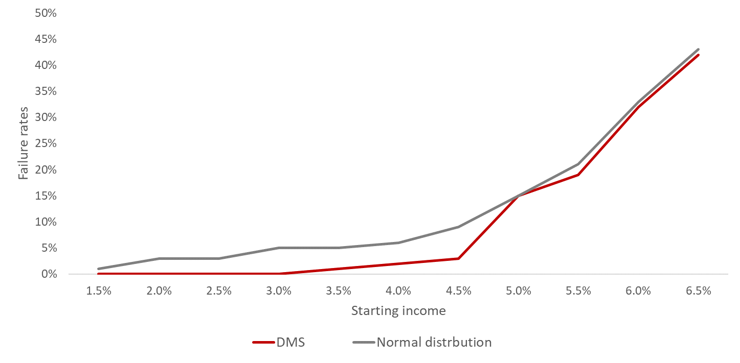
Modelling – core results
DMS rolling return data vs calibrated normal distribution
Notes:
What is Moodle?
The Actuarial society set out to improve the way course information and activities are coordinated and presented to students.
For this purpose the Moodle platform was selected and implemented in 2015 as ASSA’s Learning management system.
Moodle as a Learning Management System that is web based and allow ASSA to administer and track courses online. This platform is accessible to registered student via the web. It will be used to receive relevant course material and documentation as well as to manage submissions of assignments and other documentation for example all Work Based Learning forms and documents. The Moodle platform also allows students to collaborate and take part in other course activities such as discussion forums or the peer review of assignments.
Moodle has been used by the F200 Course Leaders over the last couple of years. In 2015 we started to implement all other courses on Moodle with a staggered roll-out plan over 3 years for all ASSA courses.
2016 will see the full implementation of all ASSA education courses on Moodle that are not currently already active on the system.
These and other Moodle functions will be discussed further on in this presentation.

Slide 8
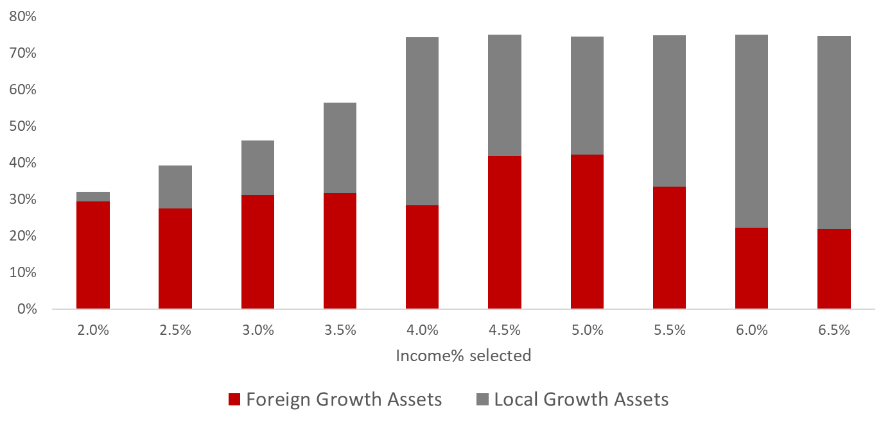
Modelling – core results
DMS optimized portfolio allocations – growth assets
Notes:
What is Moodle?
The Actuarial society set out to improve the way course information and activities are coordinated and presented to students.
For this purpose the Moodle platform was selected and implemented in 2015 as ASSA’s Learning management system.
Moodle as a Learning Management System that is web based and allow ASSA to administer and track courses online. This platform is accessible to registered student via the web. It will be used to receive relevant course material and documentation as well as to manage submissions of assignments and other documentation for example all Work Based Learning forms and documents. The Moodle platform also allows students to collaborate and take part in other course activities such as discussion forums or the peer review of assignments.
Moodle has been used by the F200 Course Leaders over the last couple of years. In 2015 we started to implement all other courses on Moodle with a staggered roll-out plan over 3 years for all ASSA courses.
2016 will see the full implementation of all ASSA education courses on Moodle that are not currently already active on the system.
These and other Moodle functions will be discussed further on in this presentation.

Slide 9
Quantifying key relationships
Maximum sustainable income (10% failure) for different portfolio parameters
 | Real Return
Real Stdev | 5% | 6% | 7% | 8% | Return ∆
10% | 4.00% | 4.90% | 5.85% | 6.80% | 0.93%
11% | 3.67% | 4.60% | 5.60% | 6.50% | 0.94%
12% | 3.40% | 4.40% | 5.30% | 6.20% | 0.93%
13% | 3.10% | 4.10% | 5.00% | 5.95% | 0.95%
14% | 2.80% | 3.80% | 4.70% | 5.60% | 0.93%
Stdev ∆ | 0.30% | 0.28% | 0.29% | 0.30%
Notes:
What is Moodle?
The Actuarial society set out to improve the way course information and activities are coordinated and presented to students.
For this purpose the Moodle platform was selected and implemented in 2015 as ASSA’s Learning management system.
Moodle as a Learning Management System that is web based and allow ASSA to administer and track courses online. This platform is accessible to registered student via the web. It will be used to receive relevant course material and documentation as well as to manage submissions of assignments and other documentation for example all Work Based Learning forms and documents. The Moodle platform also allows students to collaborate and take part in other course activities such as discussion forums or the peer review of assignments.
Moodle has been used by the F200 Course Leaders over the last couple of years. In 2015 we started to implement all other courses on Moodle with a staggered roll-out plan over 3 years for all ASSA courses.
2016 will see the full implementation of all ASSA education courses on Moodle that are not currently already active on the system.
These and other Moodle functions will be discussed further on in this presentation.

Slide 10
Application of results
Portfolio construction and style blending
Modern portfolio theory – performance signatures better than the frontier not possible?
Yet long-term studies on return and volatile signatures of different investment styles seem to indicate some volatility variations
Excessive/unnecessary volatility big negative for annuities
Volatility
Return
1:3
1:1
Notes:
What is Moodle?
The Actuarial society set out to improve the way course information and activities are coordinated and presented to students.
For this purpose the Moodle platform was selected and implemented in 2015 as ASSA’s Learning management system.
Moodle as a Learning Management System that is web based and allow ASSA to administer and track courses online. This platform is accessible to registered student via the web. It will be used to receive relevant course material and documentation as well as to manage submissions of assignments and other documentation for example all Work Based Learning forms and documents. The Moodle platform also allows students to collaborate and take part in other course activities such as discussion forums or the peer review of assignments.
Moodle has been used by the F200 Course Leaders over the last couple of years. In 2015 we started to implement all other courses on Moodle with a staggered roll-out plan over 3 years for all ASSA courses.
2016 will see the full implementation of all ASSA education courses on Moodle that are not currently already active on the system.
These and other Moodle functions will be discussed further on in this presentation.

Slide 11
Application of results
Pricing volatility reduction strategies/smoothing strategies
Smoothed investment return products often touted as more appropriate for drawdown annuities
Ignoring differences in asset allocation – smoothing charge cannot be more than 0.30% for every 1% pa reduction in real volatility
Volatility
Return
1:3
1:1
Notes:
What is Moodle?
The Actuarial society set out to improve the way course information and activities are coordinated and presented to students.
For this purpose the Moodle platform was selected and implemented in 2015 as ASSA’s Learning management system.
Moodle as a Learning Management System that is web based and allow ASSA to administer and track courses online. This platform is accessible to registered student via the web. It will be used to receive relevant course material and documentation as well as to manage submissions of assignments and other documentation for example all Work Based Learning forms and documents. The Moodle platform also allows students to collaborate and take part in other course activities such as discussion forums or the peer review of assignments.
Moodle has been used by the F200 Course Leaders over the last couple of years. In 2015 we started to implement all other courses on Moodle with a staggered roll-out plan over 3 years for all ASSA courses.
2016 will see the full implementation of all ASSA education courses on Moodle that are not currently already active on the system.
These and other Moodle functions will be discussed further on in this presentation.

Slide 12
Questions?
Author: Jaco van Tonder
Date: August 2018

