Slide 1
South Africa within a global context
Kevin Lings

Slide 2
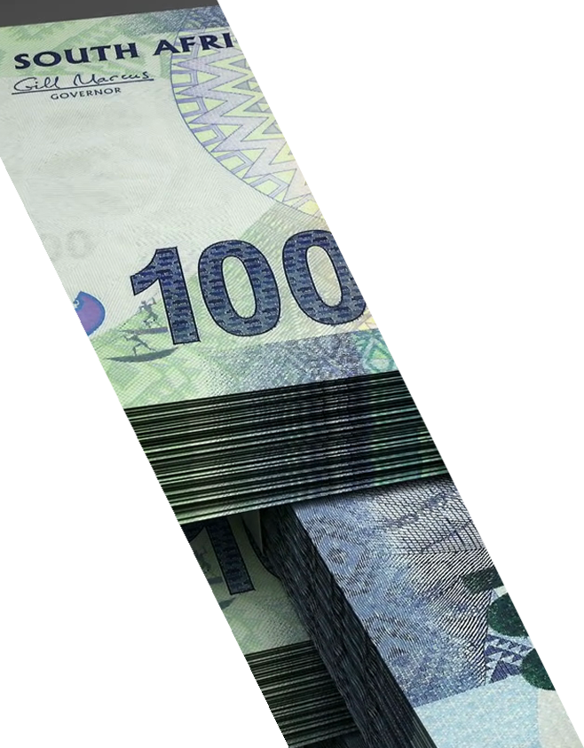





Slide 3
5
IMMEDIATE ECONOMIC CHALLENGES FACING THE COUNTRY
1
Lift business confidence
2
Restore fiscal discipline
3
Reform SOEs
4
Clarify transformation policies
5
Dramatically reduce corruption

Slide 4
2
MAJOR STRUCTURAL CHALLENGES FACING THE COUNTRY
1
Poor education outcome
2
High unemployment rates

Slide 5

South Africa school enrolment
HUGE
DROPOUT
OF STUDENTS
1.24 million
1.11 million
687 K
GRADE 1
GRADE 10
GRADE 12

Slide 6
SA university graduation rates
%, Percent graduation rate
Rhodes
University
University
of JHB
University
of CT
Stellenbosch
University
University
of the
Witwatersrand
University of the
Free State
17% of students
obtain their degree
University of
Pretoria
University of
KwaZulu-Natal
UNISA

Slide 7
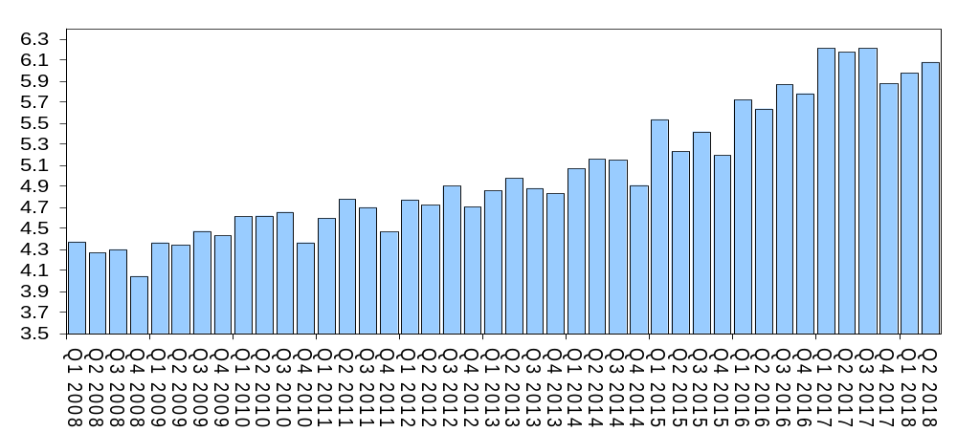
SA number of people unemployment (std def)
Million

Slide 8
South Africa youth unemployment rate
Q2 2018
Q2 2018
%
53.7%
67.1%
Excluding discouraged workers
Including
discouraged workers

Slide 9
South Africa government net domestic long-term bonds
Rbn
Fiscal years

Slide 10
SA government debt (incl contingent debt) % of GDP
% of GDP
Fiscal years
Increased to 70% of GDP

Slide 11
Private sector fixed investment as % of GDP
% of GDP
Target

Slide 12
Fixed investment spending in manufacturing declined by 33% since 2008

Slide 13
South Africa vs emerging market manufacturing
Index
Emerging market industrial production at a record high
Emerging market industrial production
SA manufacturing

Slide 14
South Africa manufacturing activity vs retail activity
Index
SA retail activity
SA manufacturing activity

Slide 15
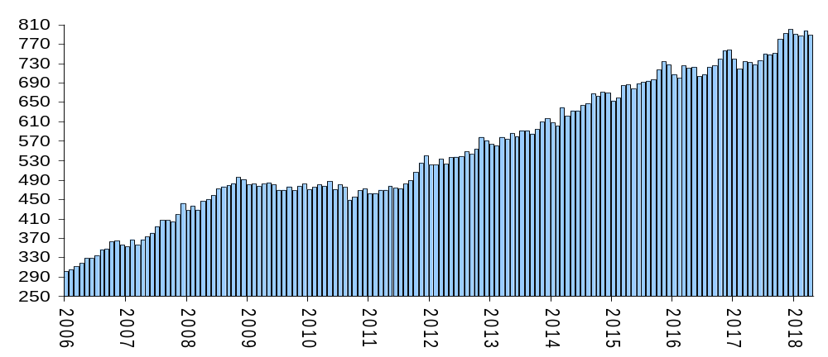
South Africa corporate deposits
R billion

Slide 16
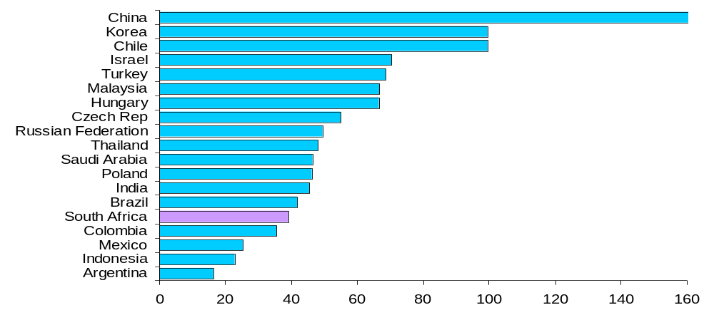
Emerging market corporate debt as % of GDP
% of GDP, end 2017

Slide 17
South Africa business confidence (BER)
Index
Source: STANLIB, Bloomberg

Slide 18
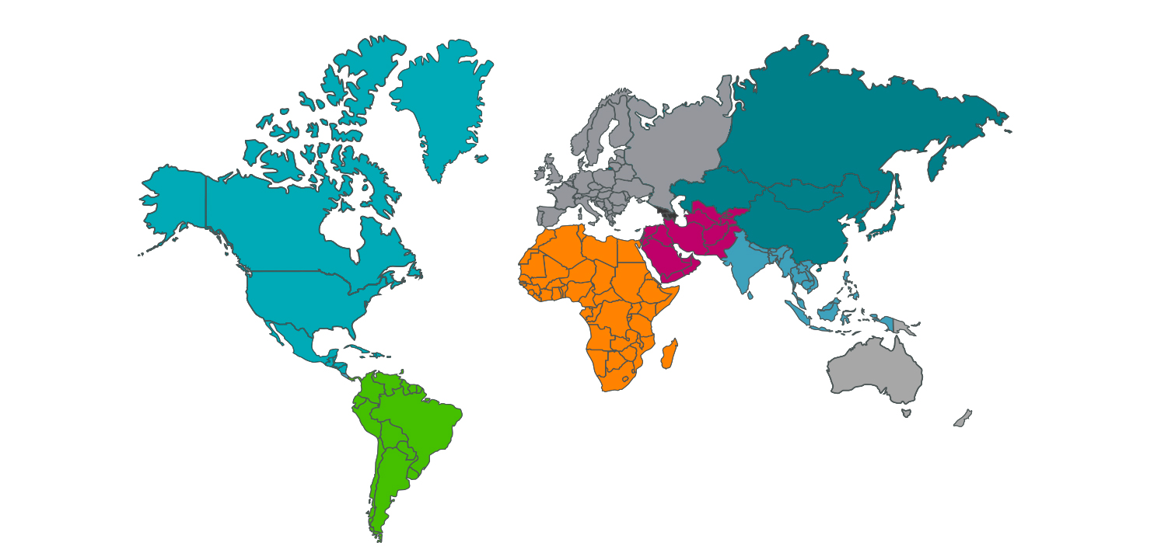
Breakdown of the world economy – estimated in 2017
Germany
4.6%
Russia
1.9%
Euro-area
15.8%
15%
UK
China
Canada
2.1%
3.3%
Japan
6.1%
USA
24.3%
3.3%
Sub- Saharan Africa
1.9%
India
South Africa
0,4%
South America
7.4%
Brazil
2.6%
1.7%
Australia

Slide 19






Slide 20
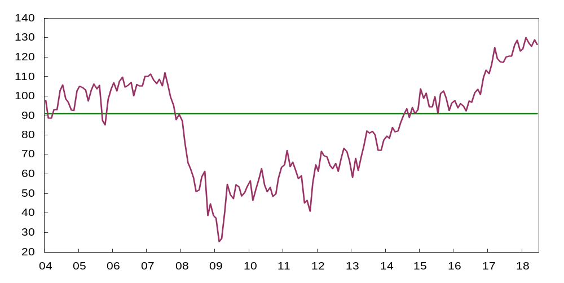
US Consumer Confidence
Index

Slide 21
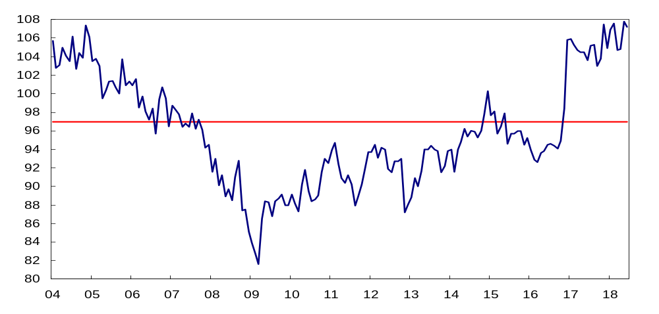
US small business confidence index (NFIB)
Index

Slide 22
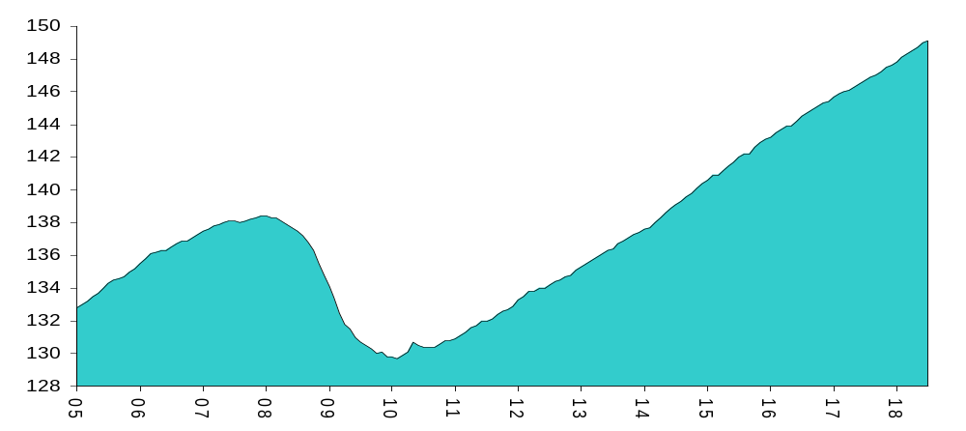
United States employment
Million
Employment is 10 million above the previous peak

Slide 23
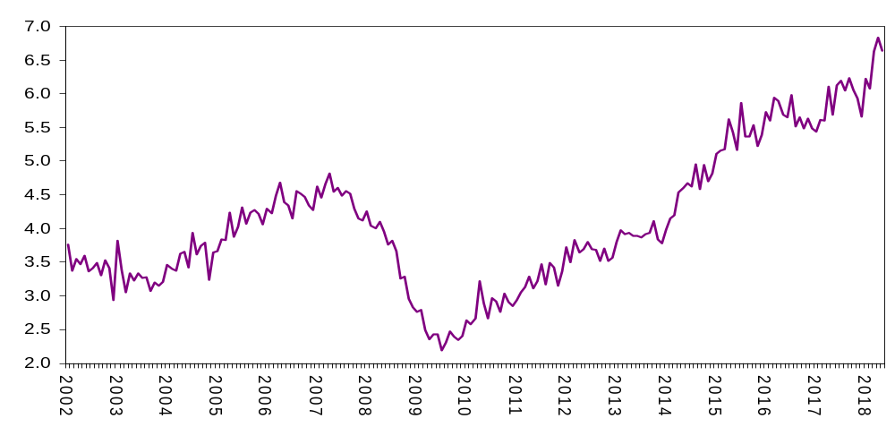
US job openings
Million, total non-farm

Slide 24
United States households: net worth
$ Billion
Another record high at end 2017

Slide 25






Slide 26
United States employment by age
Index, 12-month moving average
Age group 55 and older
Age group 35 to 49

Slide 27
United States employment by age
Index, 12-month moving average
Age group 70 and older
Age group 55 and older
Age group 35 to 49

Slide 28

Older people are more confident than younger people
Older people (35 to 54)
Young people (younger than 35)
VS

Slide 29
US percent of population aged 16 to 24 that have a car license
Percentage of age group, %

Slide 30
United States manufacturing employment as % of total
%

Slide 31
United States changing dynamics of employment
Millions of workers
Employment in health care and social assistance

Slide 32
United States real GDP Growth –
5 year moving ave
%y/y, 5-year moving average

Slide 33
Euro-area real GDP Growth –
5 year moving ave
%y/y, 5-year moving average

Slide 34
Japan real GDP Growth –
5 year moving ave
%y/y, 5-year moving average

Slide 35
Breakdown of the world economy – GDP vs population
Population
GDP
1.1%
Germany
4.6%
1.9%
9.8%
Russia
1.9%
Euro-area
15.8%
18.7%
15%
UK
China
Canada
2.1%
3.3%
0.5%
0.9%
Japan
24.3%
6.1%
USA
1.7%
16.4%
3.3%
4.3%
Sub- Saharan Africa
17,7%
1.9%
India
South Africa
South America
7.4%
Brazil
0,7%
0,4%
1.7%
5.7%
2.6%
Australia
0.3%
2.8%

Slide 36
Japan population aged 15 to 24
Millions

Slide 37
Breakdown of the world economy – GDP vs population
Population
GDP
1.1%
Germany
4.6%
1.9%
9.8%
Russia
1.9%
Euro-area
18.7%
15.8%
15%
UK
China
Canada
2.1%
3.3%
0.5%
0.9%
Japan
6.1%
USA
24.3%
1.7%
16.4%
3.3%
4.3%
Sub- Saharan Africa
17,7%
1.9%
India
South Africa
0,4%
South America
7.4%
Brazil
0,7%
1.7%
5.7%
2.6%
Australia
0.3%
2.8%

Slide 38
Developed vs emerging population aged 15 to 24
Millions

Slide 39
Thank You

