Slide 1


The Reality of Prescribed Pension Fund Assets – and other Interventions
13 June 2019

Slide 2
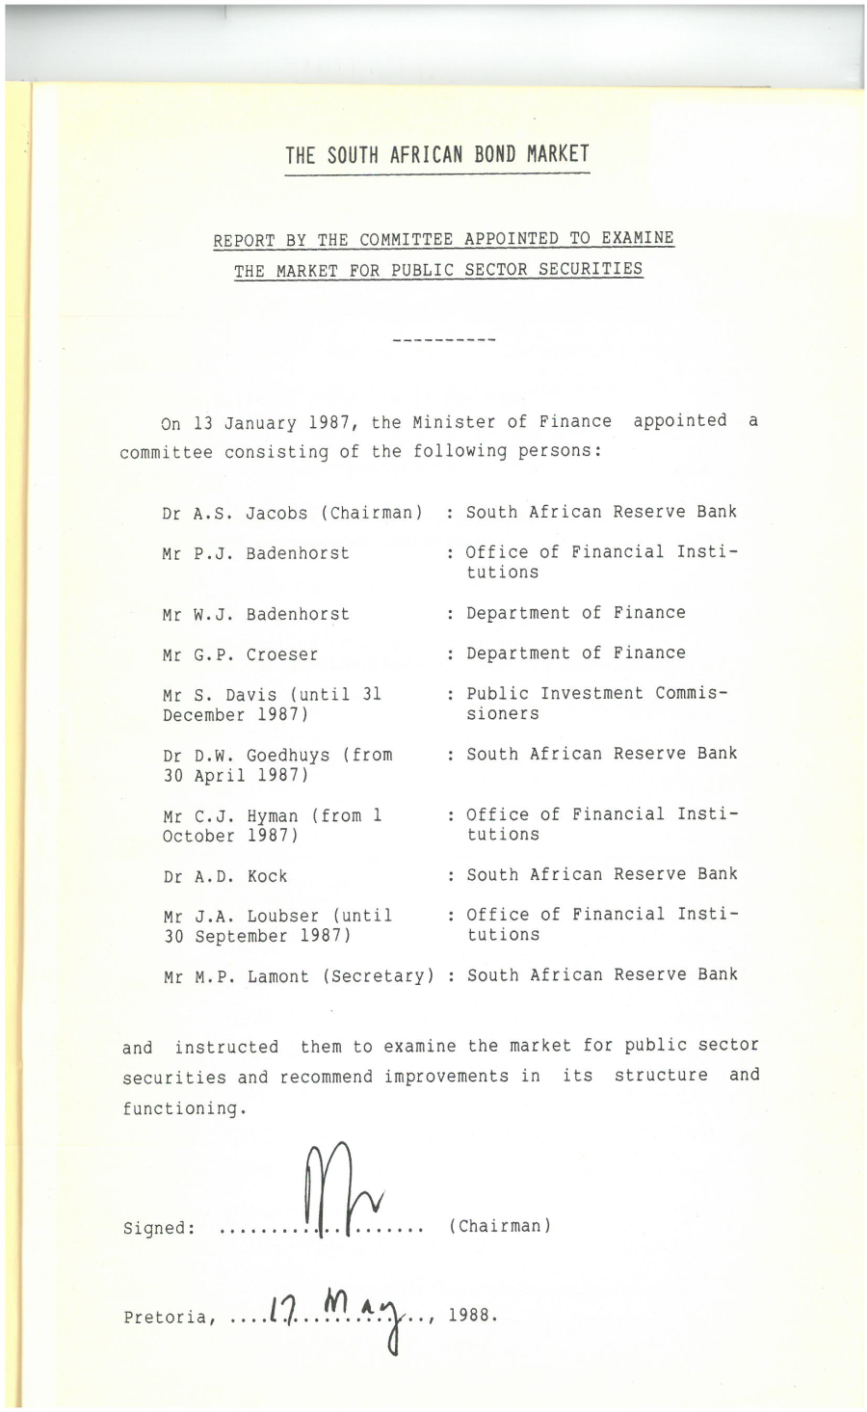


Slide 3

Agenda
Prescribed Assets
Prudential Regulations
Priority Sector Lending/Directed Credit
Local Asset Status

Slide 4
The prescribed assets question
Transform and Diversify the Financial Sector (ANC’s election manifesto)
“Investigate the introduction of prescribed assets on financial institution funds within a regulatory framework for socially productive investments (including housing, infrastructure for social and economic development and township and village economy) and job creation whilst considering the risk profiles of the affected entities”.
The question: Requirement to invest proportion of funds in instruments such as government or SOC bonds, or possibly specific projects or sectors deemed “developmental” by government.
The concern: Retirement funds become an instrument of state policy while avoiding the discipline of financial markets and fiduciary responsibility of asset managers and trustees, and imposing lower-than-market returns.
Notes:
In this context institutions are likely to include pension funds as well as insurance companies and possibly investments that fall under the Collective Investment Scheme Act
The concept of prescribed assets would require pension funds to invest a set amount of their funds in instruments such as government or SOC bonds, or possibly specific projects or sectors deemed “developmental” by government. In recent months there has been increased news flow indicating that prescribed assets continue to be a topic of debate in government circles.
There is pension industry concern that government may be seeking to make retirement funds instruments of state policy, channelling investor capital into certain preferred sectors or instruments while avoiding the discipline of financial markets and fiduciary asset managers, and thereby imposing lower-than-market returns.

Slide 5
Why should pension funds be concerned ?
The preamble to Regulation 28 states that:
“a fund has a fiduciary duty to act in the best interest of its members whose benefits depend on the responsible management of fund assets... This duty supports the adoption of a responsible investment approach to deploying capital into markets that will earn adequate risk adjusted returns suitable for the fund’s specific member profile, liquidity needs and liabilities.”
Notes:
Affects both DB and DC funds, the impact more visible in DBs:
Examples of defined benefit funds are underwritten by the employer:
GEPF underwritten by National Treasury
Transnet Pension Fund underwritten by Transnet (and ultimately by National Treasury)

Slide 6
Infrastructure as an asset class
Given the long term nature of pension fund and guaranteed annuity liabilities, infrastructure is a prudent asset class …..
But that is not the contentious issue
What is contentious is whether it should be local asset infrastructure.
Notes:
Affects both DB and DC funds, the impact more visible in DBs:
Examples of defined benefit funds are underwritten by the employer:
GEPF underwritten by National Treasury
Transnet Pension Fund underwritten by Transnet (and ultimately by National Treasury)

Slide 7
Infrastructure project funding
These may be:
Specific projects -
  Take or pay (availability based)
  Demand risk (toll roads)
General use of proceeds – Kenya/Swaziland
“funding of infrastructure in transport, water and energy sectors”
Corporate (utilities, SOEs)

Slide 8
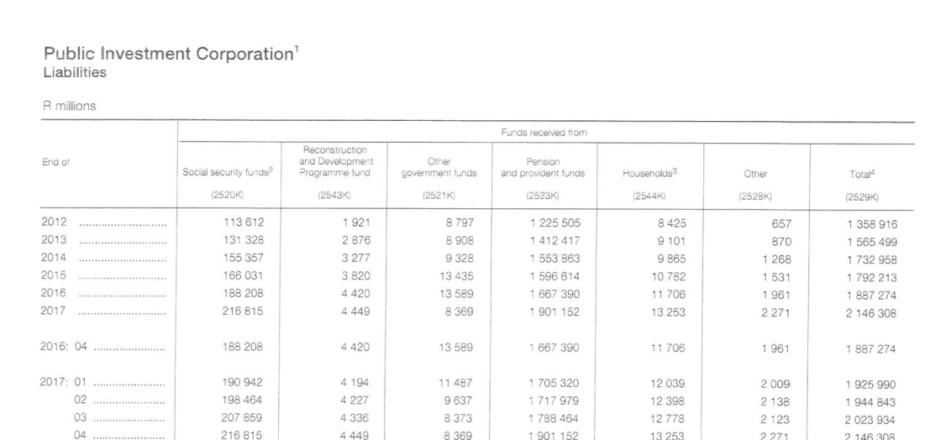
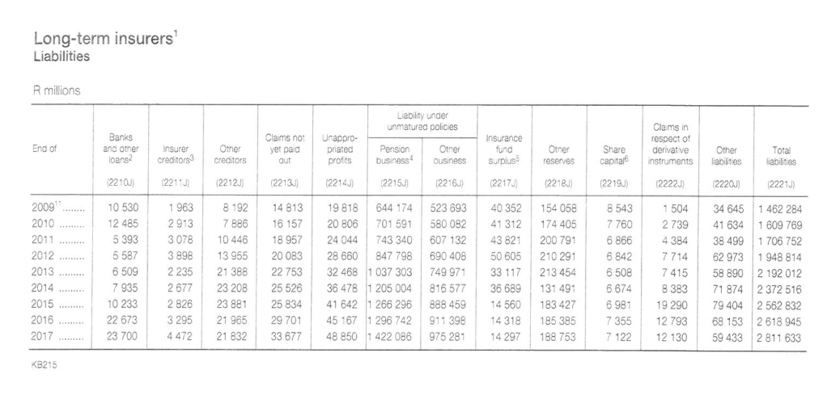

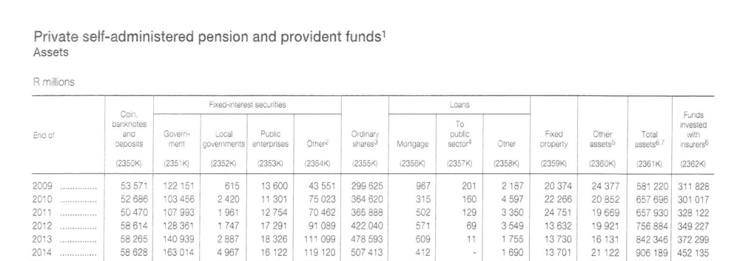
Some big numbers but not free assets
Long-term insurers Liabilities
R2,9 trillion
PIC Liabilities
R2,1 trillion
Official private self-administered pension and provident funds (A& L)
R2,0 trillion
Private self-administered pension and provident funds Assets
R1,5 trillion
These are not free assets but defined contribution pension funds and the liability is the NPV of future pensioner payments (at risk)
Notes:
Takes a long time to build up pension fund assets
Average pension fund contribution rate +/- 12% vs +/- 20% in DB days
Declining contribution to retirement provision in light of increased cost of death and disability cover

Slide 9
Big numbers - stock vs flow
The stock numbers are big
Stocks of savings are accumulated over a long time period – a percentage of salary
Any changes in asset allocation which impacts on stocks has potential systemic risks
Sale of equities would have wealth effects across the savings industry
Takes a long time to build up pension fund assets (50+ years)
Average pension fund contribution rate +/- 12% vs +/- 20% in DB days
Declining contribution to retirement provision in light of increased cost of death and disability cover
Notes:
Takes a long time to build up pension fund assets
Average pension fund contribution rate +/- 12% vs +/- 20% in DB days
Declining contribution to retirement provision in light of increased cost of death and disability cover

Slide 10
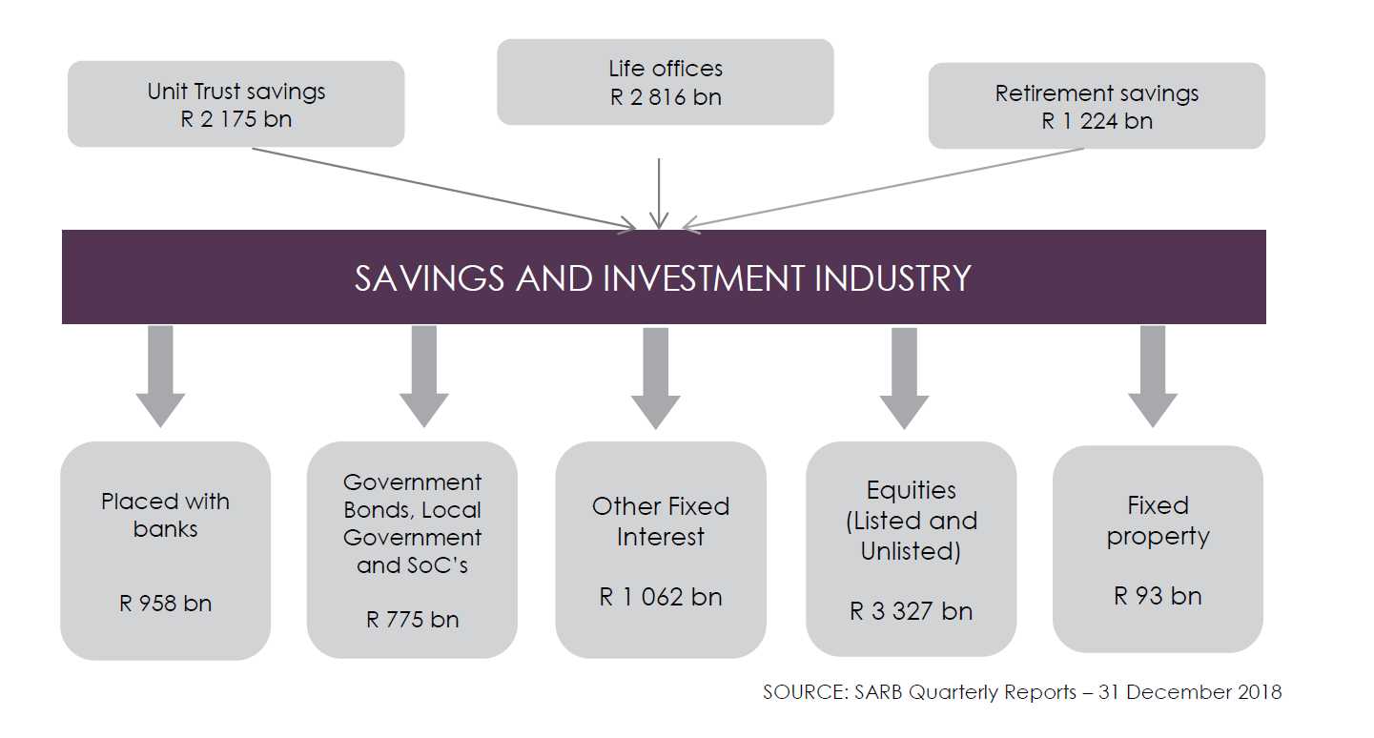
Financial Sector Asset Deployment
Notes:
Affects both DB and DC funds, the impact more visible in DBs:
Examples of defined benefit funds are underwritten by the employer:
GEPF underwritten by National Treasury
Transnet Pension Fund underwritten by Transnet (and ultimately by National Treasury)

Slide 11
Financial Sector Asset Deployment
ASISA and its members support the National Development Plan (NDP) as well as the nine-point plan set out in the State of the Nation Address (SONA) 2015 aimed at achieving inclusive growth to reignite the economy and create jobs.
To date, ASISA members have deployed capital in support of the above-mentioned goals as follows:
• SA Government, Local Authorities and State Owned Companies: R775 bn
• Other Fixed Interest (listed & unlisted) and Equities (listed & unlisted) of R4 389 bn to fund corporate SA as well as the following projects:
o Renewable energy
o Township development
o Affordable housing
o Urban regeneration
o Student accommodation
o Water
o Roads
o Agriculture (emerging farmers).
Notes:
Affects both DB and DC funds, the impact more visible in DBs:
Examples of defined benefit funds are underwritten by the employer:
GEPF underwritten by National Treasury
Transnet Pension Fund underwritten by Transnet (and ultimately by National Treasury)

Slide 12
Delving into history (1958 – 1989)
The objective: Create funds for semi-governmental institutions, such as universities, the SABC, and for developments in the former homelands by prescribing proportion of funds to be invested in government, government-guaranteed and specified approved bonds.
% Prescribed Assets (at book value)
Pension Funds 53%
Life Companies 33%
PIC 75%
The consequence:
“Originally intended as protection for policy holders and pension fund members, the prescribed investments came to be regarded in time as an assured source of public sector funding”
Jacobs 1988 p20
Section 19(1) of Pension Funds Act
Notes:
Prescribed assets were introduced in 1958 in order to create funds for semi-governmental institutions, such as universities, the South African Broadcasting Corporation, and for developments in the former homelands. To fund these institutions, pension funds and insurance companies were obliged to invest part of their funds as prescribed assets in Government Bonds, Government Guarantee Bonds, and Bonds approved and specified by the Registrar of Pensions (e.g., Homeland Bonds). Moreover, the investment community was concerned about the small amounts of holdings being kept in a particular bond, some of which were illiquid.
IMF: Guidelines for Public Debt Management 2003 p286

Slide 13
Consequences - Savings industry
 | Nominal returns (%) |  |  | Real returns (%) |  | % held in PA | Wealth tax | Opportunity cost to Equities
 | Equities | Prescribeds | Inflation | Equities | Prescribeds |  |  | Real
1960s | 11.3 | 4.9 | 3.0 | 8.3 | 1.9
1970s | 24.5 | 7.3 | 11.3 | 13.2 | -4.0 | 50 | -2.0 | -8.6
1980s | 20.2 | 13.5 | 14.5 | 5.7 | -1.0 | 44 | -0.4 | -2.9
Jacobs Committee of 1988
Investigate distortions and inefficiencies in the “gilt” market
Dual market
Illiquidity
Prescribed asset requirements: outright abolition
Establishment of :
Primary dealers
Financial Markets Advisory Board
STRATE out of JSE GCC
Bond Market Association
Source: Jacobs Committee 1988
Notes:
Real returns became negative

Slide 14
Changes in asset allocation
AA % as at: | 31.12.1986 |  | 31.03.1988 |  |  | 31.12.16
 | PF | LTI | PF | LTI |  | PIC | Other retirement | Life Co
Cash | 8.6 | 10.2 | 20.1 | 18.6 |  | 5.0 | 6.2 | 7.8
Govi Bonds | 23.4 | 9.6 | 19.0 | 11.1 |  | 23.0 | 19.8 | 7.2
Local Govi | 4.4 | 2.4 | 3.1 | 3.0 |  | 0.11 | 0.6 | 0.2
Pubic enterprises | 15.7 | 10.0 | 12.4 | 8.2 |  | 10.1 | 1.8 | 1.6
 | 43.6 | 22.0 | 34.4 | 22.3 |  | 33.2 | 22.2 | 9.1
Shares | 24.9 | 40.5 | 26.9 | 33.0 |  | 49.5 | 52.5 | 52.4
Other | 23.0 | 27.3 | 18.6 | 26.1 |  | 12.2 | 19.1 | 30.7
Total | 100 | 100 | 100 | 100 |  | 100 | 100 | 100
Prescribed asset requirements were abolished in the Budget of 1989.
Showing assets as at 1986 and 1988 to reflect the market crash in 1987.
Infrastructure or Development Assets
PIC: 1.16%
RFs and LifeCo: 2.48%
Source: SARB QB

Slide 15
Resultant changes in SA’s saving industry
Independent third party asset managers emerged after 1989
  during the era of prescribed assets, provident funds were managed by life companies due to a 33% required vs 53% for retirements fund
  the changes in taxation of life companies
Investment freedom
  funds to invest in line with their liability requirements
  growth of new products without balance sheet guarantees
Benchmarking and performance comparisons
  peer-group performance of balanced pension fund assets used as a benchmark
  changed from balanced strategies to specialist multi-asset-class approaches with benchmarked performance
  trustees less tolerant of underperforming funds
Accelerated move from DB to DC funds
Notes:
During the era of prescribed assets, provident funds were managed by life companies due to a 33% required vs 53% for retirements fund – this business moved after 1989 also due to the changes in taxation of life companies – and resulted in the emergence of independent third party asset managers eg Coronation, Investec Asset Management, RMB Asset Management inter alia
The new regulation provided more investment freedom, allowed funds to invest in line with their liability requirements and resulted in the growth of new products without balance sheet guarantees
The independent asset managers emerged locally with peer-group performance of balanced pension fund assets used as a benchmark
Large funds later changed from peer-group balanced strategies to specialist multi-asset-class approaches – the growth of performance surveys
Trustees became less tolerant of underperforming funds = more movement of funds
This also accelerated move from DB to DC

Slide 16
Consequences - Liquidity
During prescribeds era:
Bonds were valued at the lower of cost or redemption value:
most bonds were issued at a discount (very low coupon)
trading was inhibited as a sale below cost or par created an obligation to buy additional bonds to the value of the difference
the preference was “hold to maturity”
1989 changes:
Bond consolidation by National Treasury
R144, R147, R150, R153, R157 … triple legged securities
The consolidation was at “mark to market” except for public sector pension funds which were on a accrual basis
Prudential regulations
  Regulation 28 arrived from October 1989

Slide 17
Prudential regulations
Most countries have quantitative limits on pension funds:
Only 8/77 have no ceilings – Australia, Belgium, Canada, Netherlands, New Zealand, UK, US and Malawi
Upper limit on equities in 55/77 countries
Minimum limits in equity in Zambia, Chile and Colombia
Most have limits or forbid investment in real estate, private investment funds
Floors on investments exist – in Israel 30% must be in earmarked bonds, in NZ 15% must be in growth assets, in Poland investment in treasury bonds and state-backed bonds are no longer allowed
Certain countries forbid investing abroad – Dominican Republic, Eqypt, India and Nigeria
In US employer-related loans are not allowed
Source: OECD Survey of Investment Regulations on Pension Funds 2018

Slide 18
Have regulations reduced investment in infrastructure ?
“While the availability of infrastructure projects has increased, market participants continue to cite a lack of sufficient investable projects.”
Most countries, pension funds only have a small share of infrastructure investments. In OECD survey, investment in infrastructure via unlisted equity and debt represented only 1.1% of assets under management.
Exceptions are found in Australia and Canada, where the average infrastructure investment by pension funds is particularly high.
Defined contribution (DC) pension vehicles often offer daily pricing or liquidity, which may be difficult to reconcile with long-term, illiquid asset classes such as infrastructure.
The empirical analysis and other qualitative sources suggest that the effect of G20 financial reforms on infrastructure has been of a second order relative to other factors.
Notes:
“There is no shortage of private capital and while there is a supply of projects, not all of them are “bankable”

Slide 19
Priority Sector Lending/Directed Credit
Directed lending or funding, and complex and distorting subsidy regimes result in a system wherein banks do not function as autonomous profit-maximizing entities, but to some extent as quasi-fiscal bodies, providing virtual subsidies to selected segments of the economy which do not appear on the general government balance sheets.
(RBI September 2005)

Slide 20
Priority Sector Lending – examples
Characteristic /Impact Area | Japan | Korea | China | Brazil | Thailand
Priority Sectors | Export, large scale industry, small scale industry and agriculture | Export, heavy and chemical industry | Large state owned enterprises | Rural areas, agriculture, infrastructure and housing finance | Exports, small scale industry, agriculture
Implementing Institutions | BoJ, govt owned financial institutions, commercial banks | BoK, govt owned financial institutions, commercial banks | BoC, policy banks | Public sector banks, commercial banks | BoT, specialised govt institutions
Main source of funds | Postal savings, commercial bank credit | Central bank credit, foreign debt capital | Central bank credit, foreign debt capital (mainly Chinese diaspora) | Government credit, demand deposits of commercial banks | Commercial bank credit
Monitoring and supervision | High level of supervision | High level of supervision | Relatively little supervision | Very little supervision | Little supervision
Costs and loan losses | Low costs as govt absorbed losses | High loan losses | High loan losses | High loan losses | Inefficiency in banking sector due to interest rate caps
Impact | Beneficial for industry but costly | High NPAs, costs borne by banks | High NPAs, high inflation | High NPAs, high inflation | Positive impact on PS only after deregulation
Source: Nathan and Associaties 2013
Notes:
Japan: post WW2 Export oriented and industrialisation – selected for externalities and govt absorbed loan losses- mixed results
Korea - an impoverished state, largely dependent on foreign aid, can coordinate directed credit and industrial policy to lay the groundwork for industrialization. In the 1960s, directed credit was used to promote exports, earn foreign exchange, and build industries.
1970s HCI. The banking system became inefficient and economic development imbalanced. The drive to use bank credit to promote priority sectors and government control of credit led to inadequate screening of projects and an alarming accumulation of NPLs.
China: From the 1980s to the late 1990s, this policy of directed lending provided unviable state-owned enterprises with funds for working capital and new investment to create jobs and meet objectives for housing, education, health, and pensions. In 1994, the policy changed. The state banks were commercialized and policy-based lending was channeled through three new banks, the Export-Import Bank, the Agricultural Development Bank, and the China Development Bank.
Brazil: 2003 -> Banco do Brasil and the Caixa Econômica Federal, are entrusted with the task of ensuring that credit is available for rural areas, agriculture, infrastructure and housing. With the exception of microfinance institutions, Brazil’s earmarked credit programs have not reached the intended beneficiaries and have crowded out private credit. Inequality in land ownership, for example, has resulted in inequality in credit allocation, with the wealthiest 2 percent of borrowers receiving more than 57 percent of the loans, while the poorest 75 percent receive a mere 6 percent. Because most directed credit is mandated, banks cross-subsidize, raising interest rates for loans to non priority sectors and increasing the overall cost of financing in those sectors.
Thailand: Interest rate ceilings. In 1989-1992 ceilings on lending and interest rates imposed by the BOT on commercial banks were removed.168 This was followed by a relaxation of portfolio requirements, although the BOT continued to exercise control over the financial sector. Interest rate deregulation improved priority sectors’ access to financial services. 1997 financial crisis ……

Slide 21
Priority Sector Lending – outcomes
Experience of countries that have used directed credit programs shows that the overall costs of implementing such programs are enormous relative to the benefits that they generate, thus reducing the net benefits to the economy. Consequently, several countries (barring a few, including Brazil and India) have phased out their directed credit policies
Common outcomes – high NPLs, inflation and misallocation of financial resources
In Zambia, Nigeria, Ghana and Egypt, pension funds were forced to invest in government investment vehicles – with negative real returns resulting in bankruptcy of the savings institutions.
Source: Nathan and Associaties 2013

Slide 22
Directed investments and priority sector lending
Criteria to minimise adverse effects
Large spill over effects that cause social benefits > private benefits
Preferred activities should have difficulty in obtaining finance from ordinary market sources:
  High investment risks or information costs such as SMEs, but not infrastructure
Cost and scope of eligible assets should be small to minimise distortions in the allocation of resources
Maintain positive real returns
Maintain fiscal discipline

Slide 23
Local asset status
Country | Local asset requirement
Ghana | 100%
South Africa | 75-80%
Swaziland | 50%
Namibia | 45%
Botswana | 30%

Slide 24
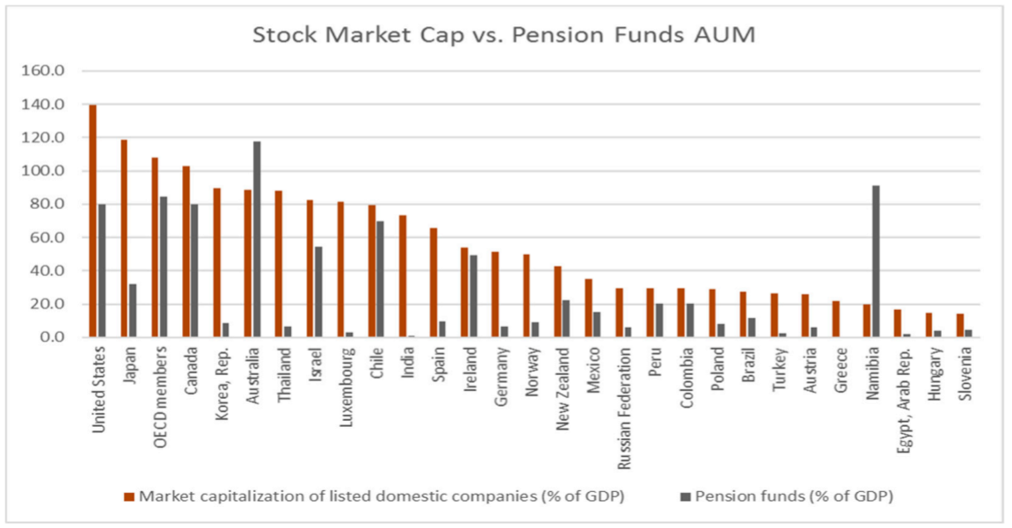
Namibia – Deep institutional savings pool
IMF Namibia Financial Stability Assessment March 2018 p30

Slide 25
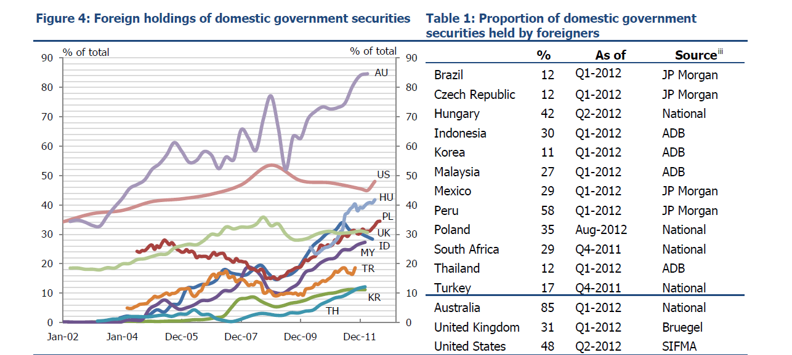
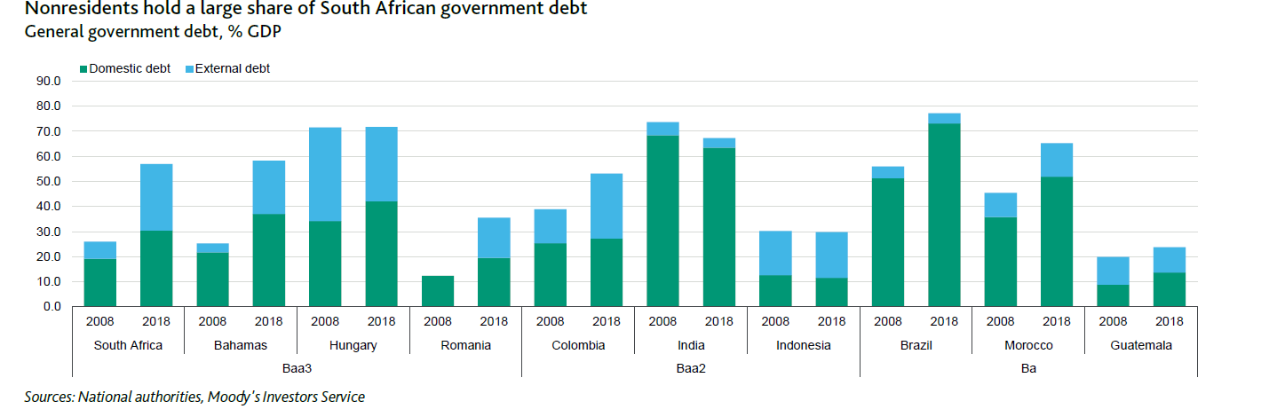
Foreign holdings of LCBs
Sienaert World Bank Dec 2012

Slide 26
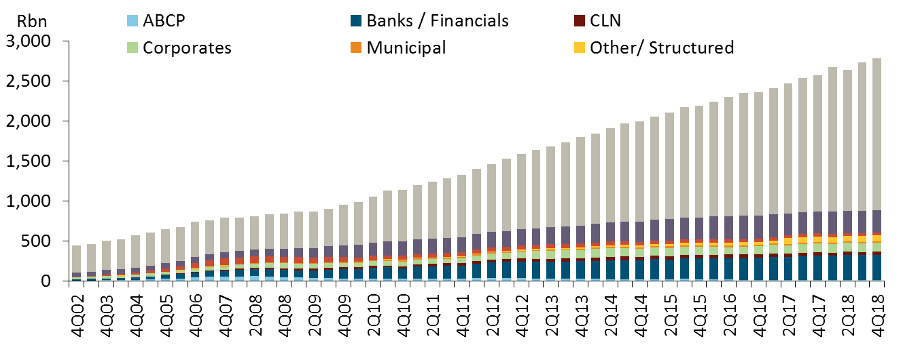
SA: Robust debt capital market
JSE listed debt instruments - volume outstanding
Government Bonds: Approximately R1.9 trillion of the bond market
Corporate Bonds: In 2018 corporate issuers raised R34bn, outstanding R113bn
Financial Institutions and Banks. Total outstanding of R320bn
State-owned companies and municipalities: Total outstanding of R275bn
Source: JSE, RMB Global Markets
Notes:
Government Bonds: Approximately R1.9 trillion of the bond market consist of government issuances. These instruments account for approximately 66% of all liquidity reported to the JSE.
Corporate Bonds: In 2018 corporate issuers raised R34 billion. The total nominal issuances outstanding is approximately R113 billion.
Financial Institutions and Banks: In 2017 alone the financial services industry issuances comprised R73.5 billion (50%) of total debt issuances, in 2018 was R47bn. This sector has total outstanding of R320 billion which is 12% of the total bond market in 2018.
State-owned companies and municipalities: R21 billion of issuance volume in 2018. This comprises 10% of total bond market at an amount outstanding of R275 billion.

Slide 27
SOCs or infrastructure?
Corporate governance, profitability and a sustainable business model is not a new topic for SOCs
Financial institutions have indirectly participated in the funding of public sector expenditure through the uptake of government and SOC bonds valued at R1.3 trillion in the last 10 years.
Banks, non-bank financial institutions and asset managers financed over R200bn towards 112 projects for the Independent Power Producers Programme.
Direct finance through Public-Private Partnerships (PPP) has been in decline, with only R5bn in projects being finalised in 2016/17.
Thirty-three completed PPP projects since 1998, total value of R89.3bn including hospitals, transport and roads, tourism and head office accommodation.
PPP projects account for R18.5 billion – a mere 2.2% of the total public-sector infrastructure budget estimate of the R834.1bn planned for public sector infrastructure spending over the next three years
National Treasury, 2018/19 Budget Review, pages 153-155
Notes:
Pension funds voluntarily invest – question of risk vs return
In line with sound investment principles that take account of the need for secure capital and income in particular and diversification in general
Investing a percentage of a fund in developmental initiatives entails not only prescription but an acceptance that terms and conditions are not market related

Slide 28
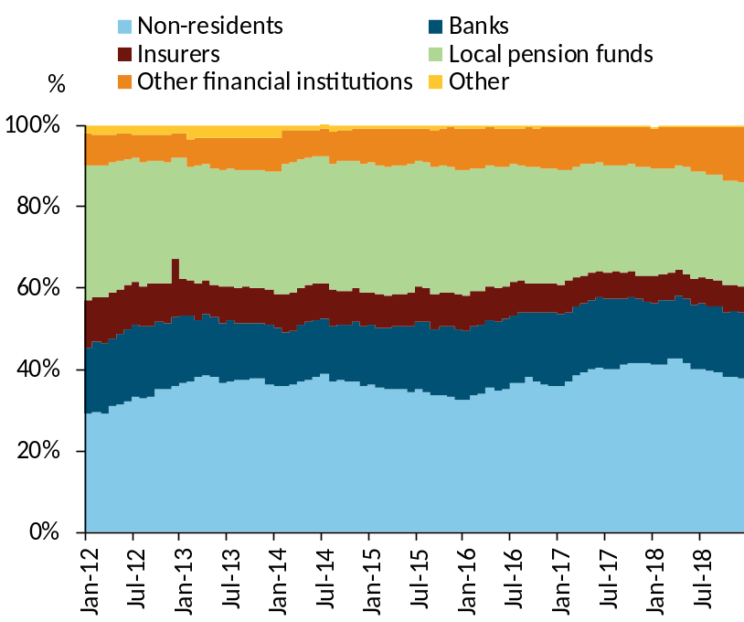
Pre-1989 vs now – the difference?
Then: SA was a closed economy
Now:
World: Interconnectedness of financial markets
South Africa:
- Open economy
- Diversified bondholders
±38% of ZAR government bonds are held by foreigners
- Member of G20: Financial reforms to reduce systemic risk
Basel III/IV (plus SAM)
Twin Peaks
Macro prudential tool kit
Resolution framework
Margining of OTC derivatives
Consolidated supervision of conglomerates
Holdings of listed bonds

Slide 29
Lack of demand or lack of supply ?
Beware unintended consequences
Prescribed investments in developmental projects with below commercial returns will not be welfare enhancing for the economy.
They could even be wealth destructive if foreigners sell bonds, and local funds sell equities to meet the requirements.
Notes:
There are other sources of funding when the fiscus is constrained

Slide 30
NOTES

Slide 31
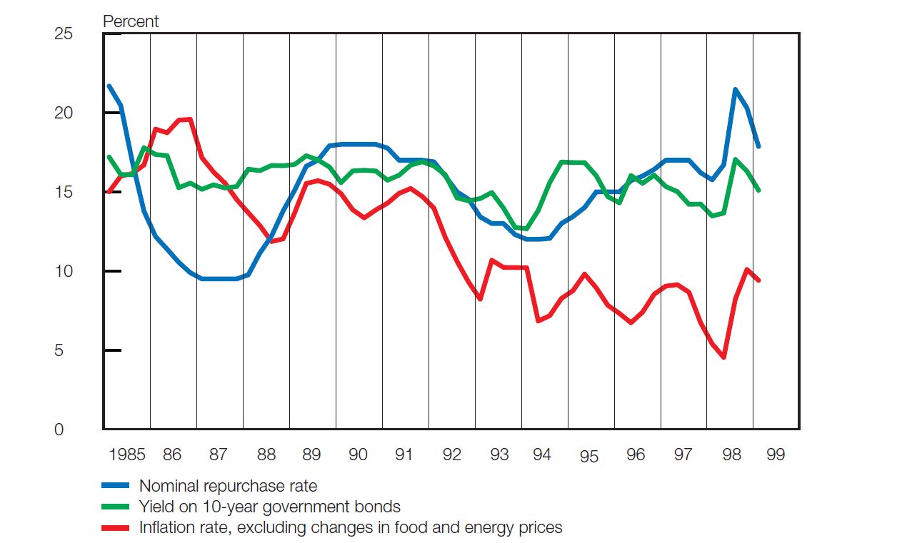
What happens when L > A ?
The Transnet Pension Fund experience:
Company incorporated on 1 April 1990, and the Transnet Pension Fund established
Inherited an actuarial deficit of R17,1bn of which R10,3bn was provided for
During 1990/91 and 1991/92 financial years the company issued R10,3bn non-tradeable Pension Fund Debentures (T011) with a coupon of 16.5%
The T011s were bought by PIC
Notes:
Transnet Limited (the company) was incorporated on 1 April 1990
The Transnet Pension Fund was established in terms of the Transnet Pension Fund Act no 62 of 1990
It inherited an actuarial deficit of R17,1 billion of which R10,3 billion was provided for
During 1990/91 and 1991/92 financial years the company issued R10,3 billion non-tradeable Pension Fund Debentures (T011) with a coupon of 16.5%
The T011s were bought by PIC

Slide 32
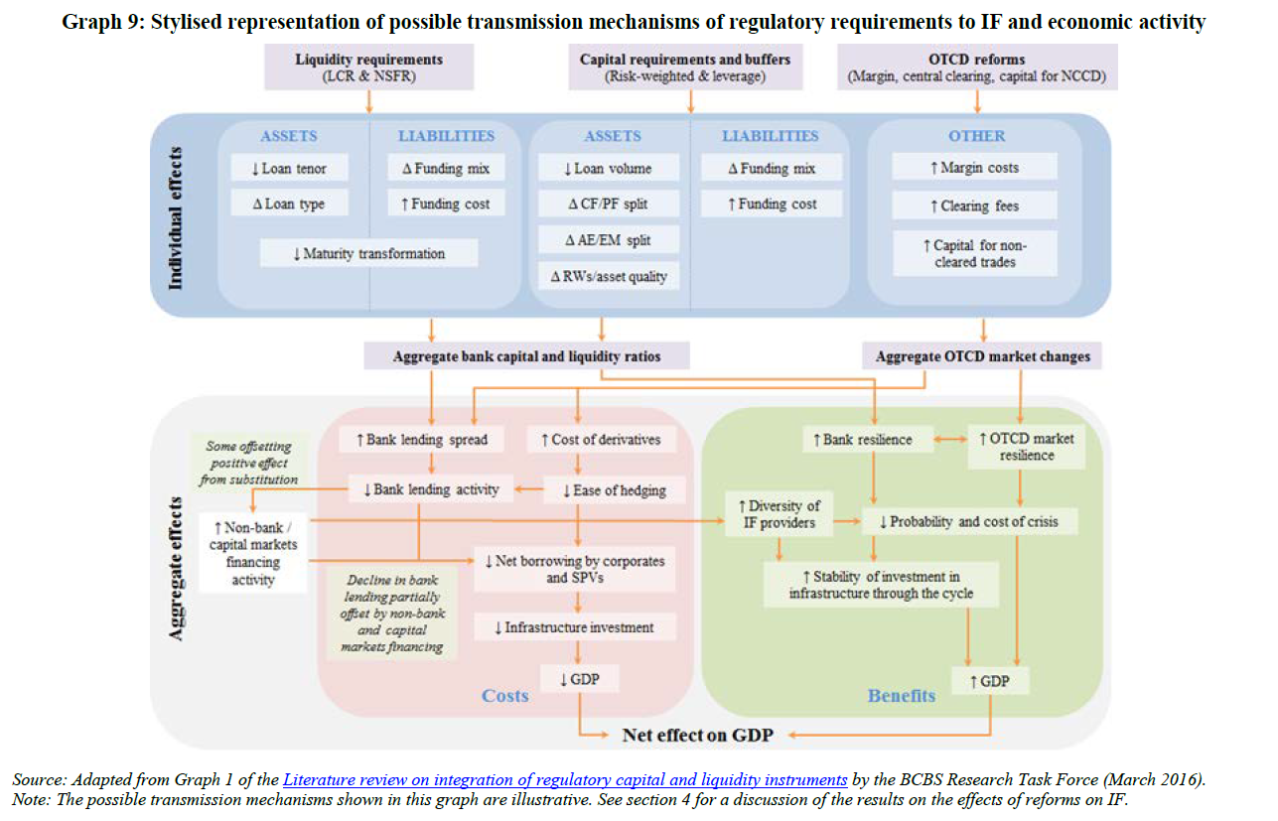

Slide 33
Its not new - 2003 Growth Summit
5% pension fund assets to be invested in developmental projects
5% * R5.6 trillion = R280 billion
But we run the risk of the fallacy of percentages…
It takes a long time to build up these pension fund assets
  Average pension fund contribution rate +/- 12% vs +/- 20% in DB days
  Declining contribution to retirement provision in light of increased cost of death and disability cover
5% in developmental initiatives is effectively a tax on
(contributions + returns – costs)
Borne by all members – some ordinarily exempt from paying tax in their personal capacity
A pension fund is effectively a tax free investment – forget about the R35k or so per annum tax free allowance

Slide 34
Directed Credit Programmes and Priority Sector Lending
India has had PSL since 1969 when the banks were nationalised
The motives behind government programmes to provide directed credit to agriculture and industry can be traced to asymmetrical information
Agriculture: farmers accumulate wealth to own their land and this improves the allocation of resources
Industry: benefits include product and factor market externalities as well as direct benefits of relaxing lender constraints
HOW it is done is important in whether it can achieve legitimate objectives
Influence peddling and soft repayment terms lead to inefficiencies
Other mechanisms can ensure the proper allocation and repayment of funds
Market failure

Slide 35
Priority Sector Lending (NOTES)
Japan: post WW2 Export oriented and industrialisation – selected for externalities and govt absorbed loan losses- mixed results
Korea - an impoverished state, largely dependent on foreign aid, can coordinate directed credit and industrial policy to lay the groundwork for industrialization. In the 1960s, directed credit was used to promote exports, earn foreign exchange, and build industries.
1970s HCI. The banking system became inefficient and economic development imbalanced. The drive to use bank credit to promote priority sectors and government control of credit led to inadequate screening of projects and an alarming accumulation of NPLs.
China: From the 1980s to the late 1990s, this policy of directed lending provided unviable state-owned enterprises with funds for working capital and new investment to create jobs and meet objectives for housing, education, health, and pensions. In 1994, the policy changed. The state banks were commercialized and policy-based lending was channeled through three new banks, the Export-Import Bank, the Agricultural Development Bank, and the China Development Bank.
Brazil: 2003 -> Banco do Brasil and the Caixa Econômica Federal, are entrusted with the task of ensuring that credit is available for rural areas, agriculture, infrastructure and housing. With the exception of microfinance institutions, Brazil’s earmarked credit programs have not reached the intended beneficiaries and have crowded out private credit. Inequality in land ownership, for example, has resulted in inequality in credit allocation, with the wealthiest 2 percent of borrowers receiving more than 57 percent of the loans, while the poorest 75 percent receive a mere 6 percent. Because most directed credit is mandated, banks cross-subsidize, raising interest rates for loans to non priority sectors and increasing the overall cost of financing in those sectors.
Thailand: Interest rate ceilings. In 1989-1992 ceilings on lending and interest rates imposed by the BOT on commercial banks were removed.168 This was followed by a relaxation of portfolio requirements, although the BOT continued to exercise control over the financial sector. Interest rate deregulation improved priority sectors’ access to financial services. 1997 financial crisis ……

Slide 36
Pension funds voluntarily invest risk vs return
In line with sound investment principles that take account of the need for secure capital and income in particular and diversification in general
Investing a percentage of a fund in developmental initiatives entails not only prescription but an acceptance that terms and conditions are not market related
There are other sources of funding when the fiscus is constrained –
5% Transitional levy: To finance transitional costs incurred during the 1993 and 1994 transitional process to democracy, a one-off transitional levy was charged during the 1995 year of assessment. This levy was calculated as a certain percentage of taxable income in excess of R50 000 before set-off of any balance of assessed loss brought forward.

