Slide 1
The missing link:
Economic exposure and pension plan risk
Paul Sweeting
Chief Risk Officer
Hassana Investment Company

Slide 2
Overview
Defined benefit pension plans do not exist in isolation
They must be funded somehow
Many (most?) DB plans are in deficit
Ability of sponsor to make good any deficit is key
This is known as the sponsor covenant
Applies to private sector and state schemes

Slide 3
Sponsor covenant risk
All sponsors are exposed to risks
Some are quite general (e.g. economic growth)
Some are more specific (e.g. particular commodities)
Sometimes several distinct factors are involved
These factors affect not just the sponsor…
…they may also affect the investments backing the liabilities

Slide 4
The analysis
Two parts to this analysis
  Measuring the exposure of the pension plan to economic risks affecting the sponsor
  Adjusting the asset allocation of the pension plan to make it more resilient against such risks

Slide 5
Generating investment returns
The model used recognises observed investment features
  Returns in illiquid assets are “unsmoothed”
  Asset class returns are modelled using skew-t distributions
  Returns are linked using a t-copula
Pretty good results could be obtained just using a multivariate normal distribution…
…but if illiquid assets should still be unsmoothed

Slide 6
Measuring risk: VaR and CVaR
VaR (Value at Risk) measures the point beyond which losses are unlikely to occur with a particular degree of confidence over a particular time horizon
  A 99% one-month VaR of -3.5% tells you that there is a 1% chance that losses will exceed 3.5% in any month
Cvar (Conditional Value at Risk) measures the average losses between the threshold
  A 99% one-month CVaR of -5% tells you that the average of the worst 1% of losses expected for a given month is 5%

Slide 7
Measuring risk: extension to CRCVaR
CRCVaR (Conditional Return CVaR) uses the same principal as CVaR…
…but is conditioned on an external risk
  A 99% one-month portfolio CRCVaR of -4% conditioned on the oil price tells you that for the worst 1% of oil price falls for a given month, the average loss on the portfolio is 4%
Mathematically, if CVaR = E[X|X<x]…
…CRCVaR = E[X|Y<y]

Slide 8
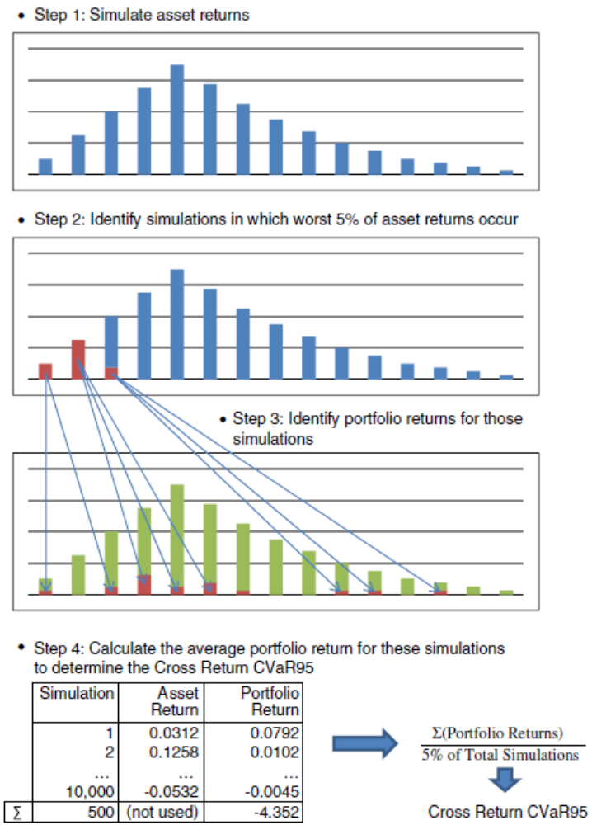
CRCVaR: a graphical explanation
Assume that the asset of interest is the price of oil…
…and we are interested in CRCVar95
We simulate the returns on both the asset and the portfolio…
…then calculate the average of the latter based on the tail of the former

Slide 9
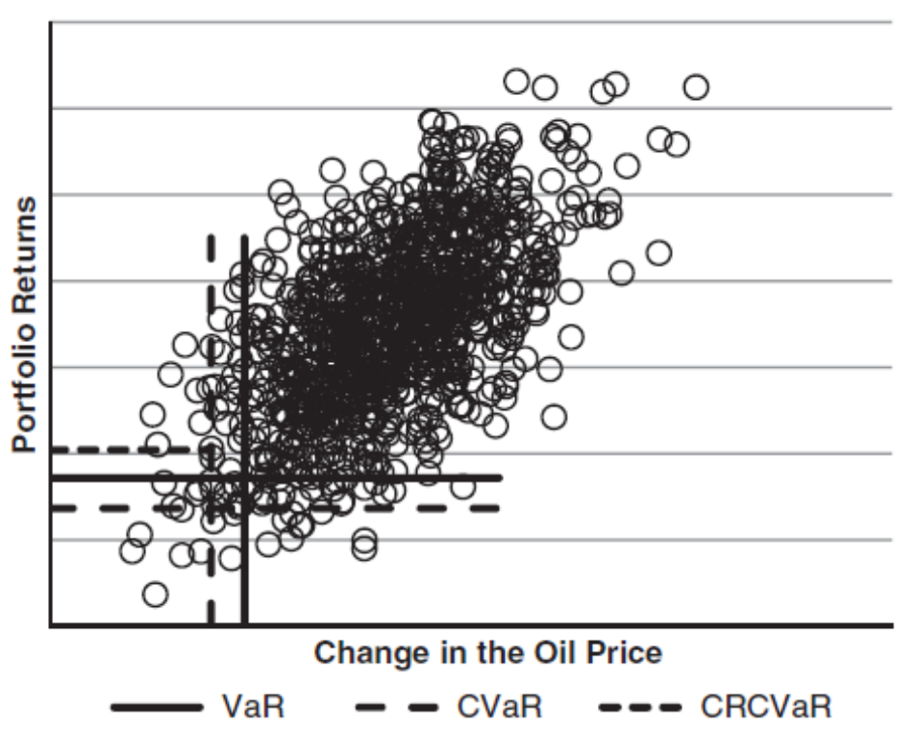
CRCVaR: another graphical explanation
VaR or CVaR can be calculated for the portfolio or the oil return
But CRCVaR calculates the average return conditioned on the change in the oil price

Slide 10
Improving portfolio resilience
Two potential approaches covered here
  Changing the allocation between asset classes
  Changing the allocation within asset classes

Slide 11
Changing the asset allocation
If an asset allocation is efficient, changing it to improve the CRCVaR will move it to a different point on the frontier…
…or will make it less efficient
As such, this is best used to help guide decisions…
…or when optimal asset allocations are undesirable
This depends on how return assumptions are derived

Slide 12
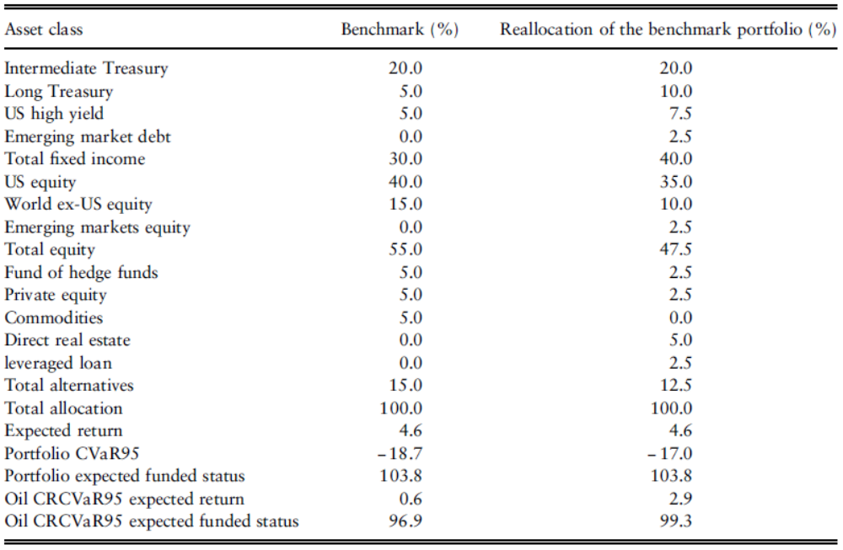
Sample asset class reweighting

Slide 13
Using alternative equity benchmarks
Start with an equity index
Calculate the market-implied sector returns…
…based on weights, volatilities and correlation
Similar to the starting point for the Black-Litterman model
Underweight sectors positively correlated to risk factor…
…and overweight those negatively correlated to risk factor
This can be done through optimisation

Slide 14
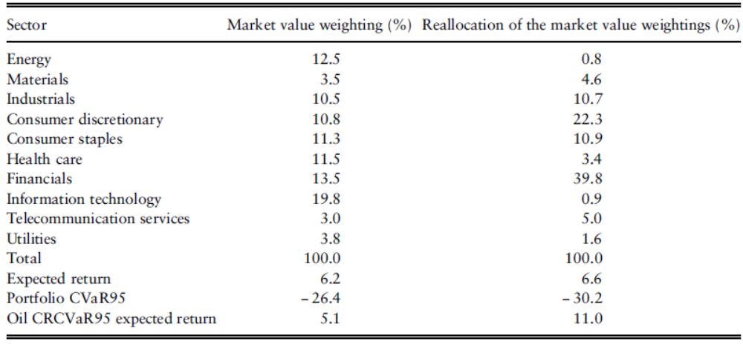
Sample sector reweighting for the S&P500

Slide 15
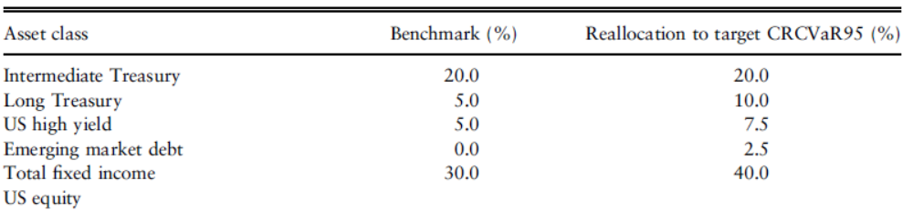
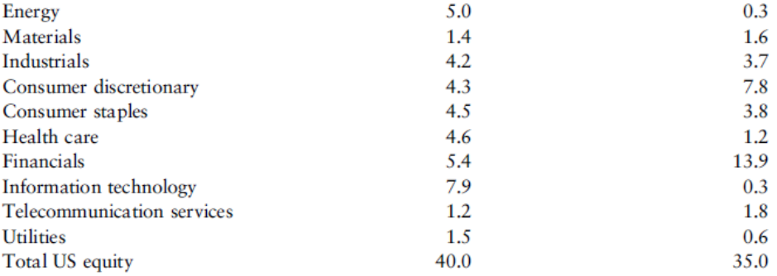
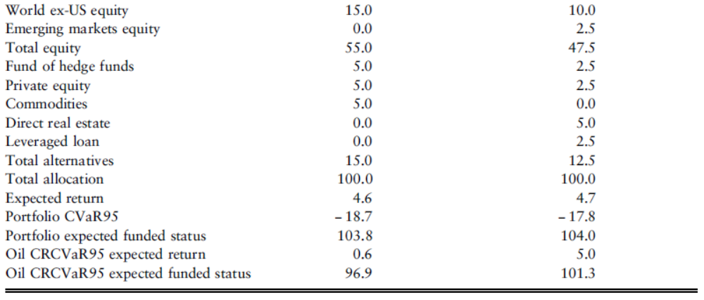
Combined asset class and sector reweighting

Slide 16
Other considerations
We focus on scenarios where a drop in the oil price is bad…
…but in some industries, this is good (e.g. aviation)
Other commodities can also be used
Combinations of risk factors can be constructed…
…by regressing risk factors on earnings, or even share price

Slide 17
